Slide 1
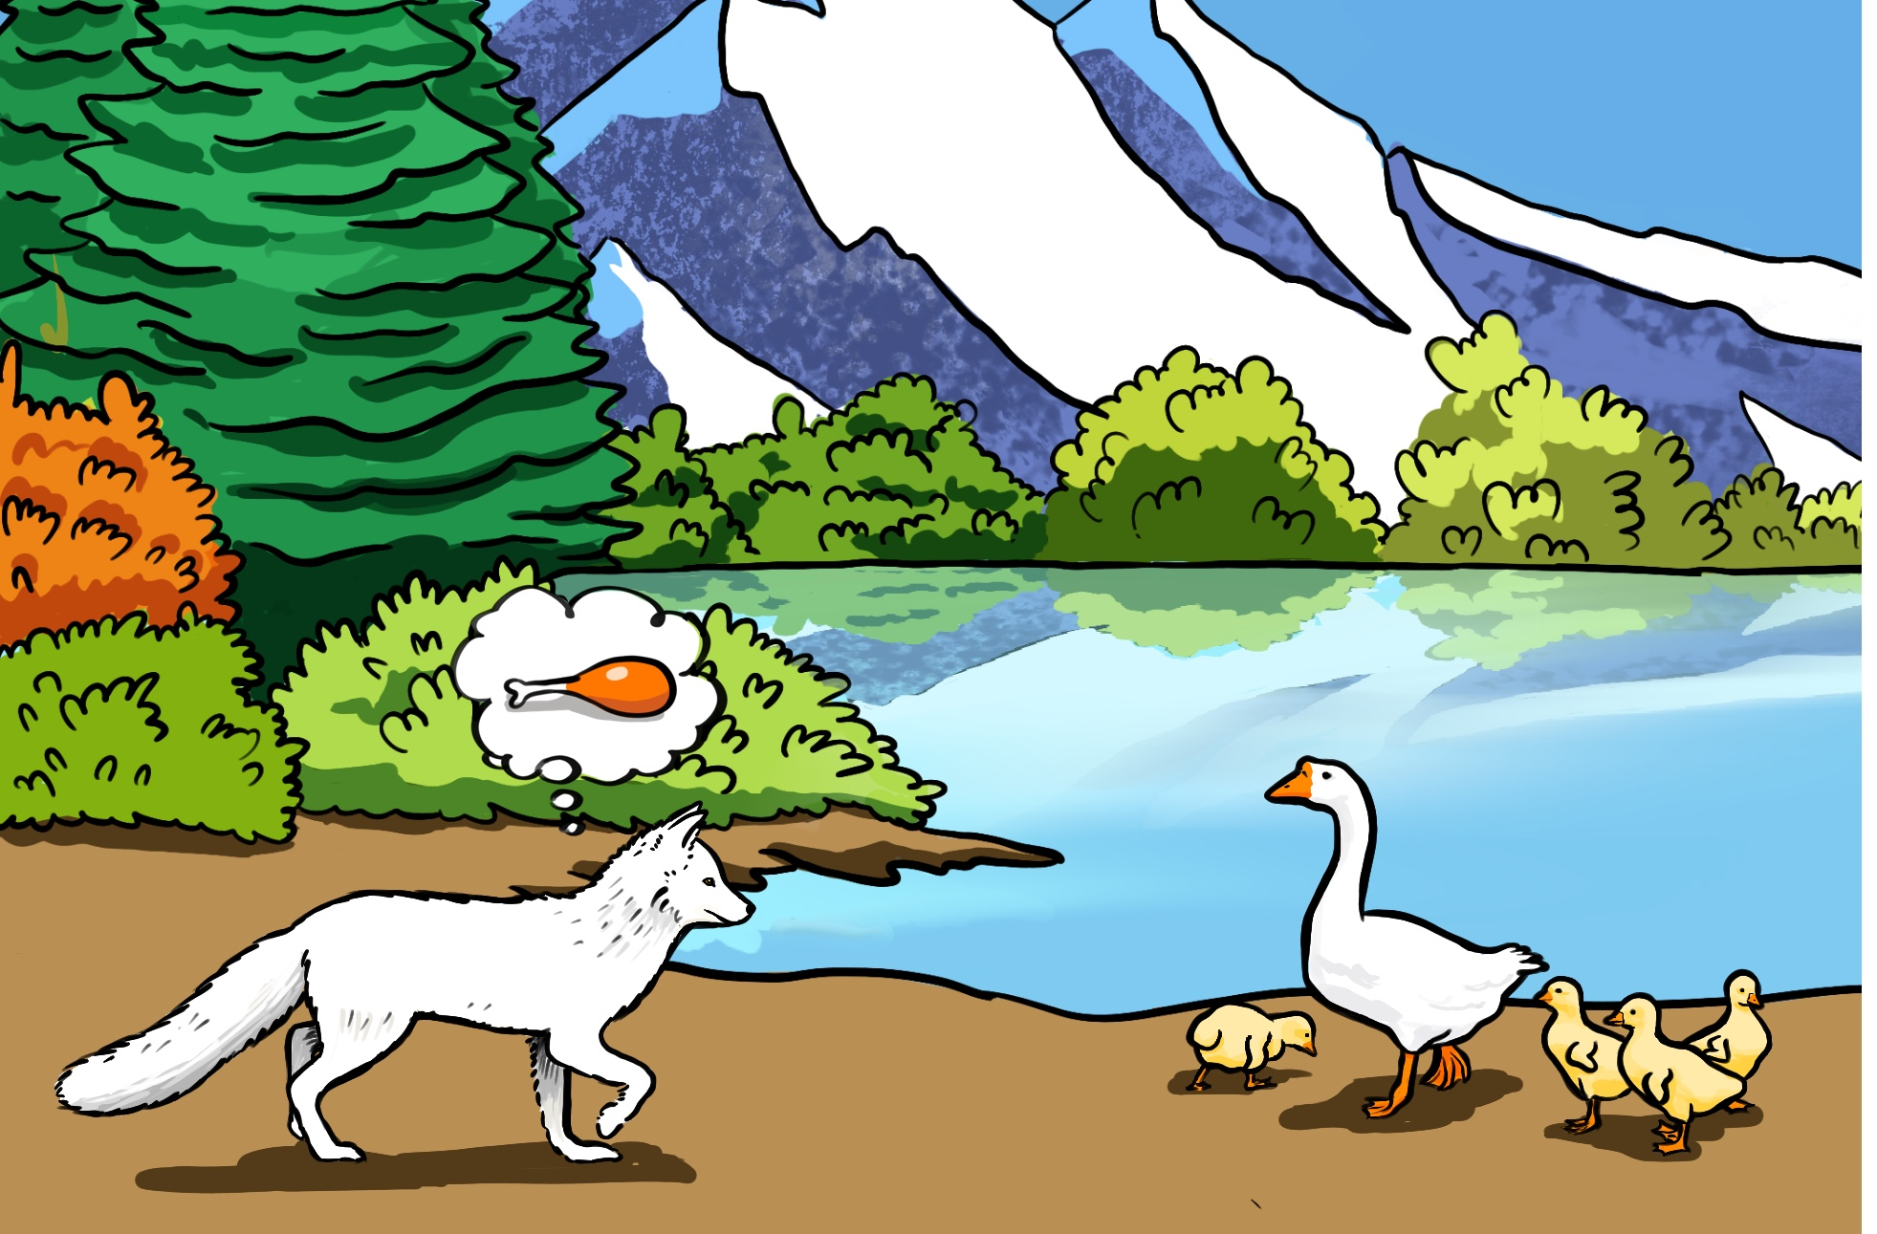
Anger is a bad counsellor

Slide 2
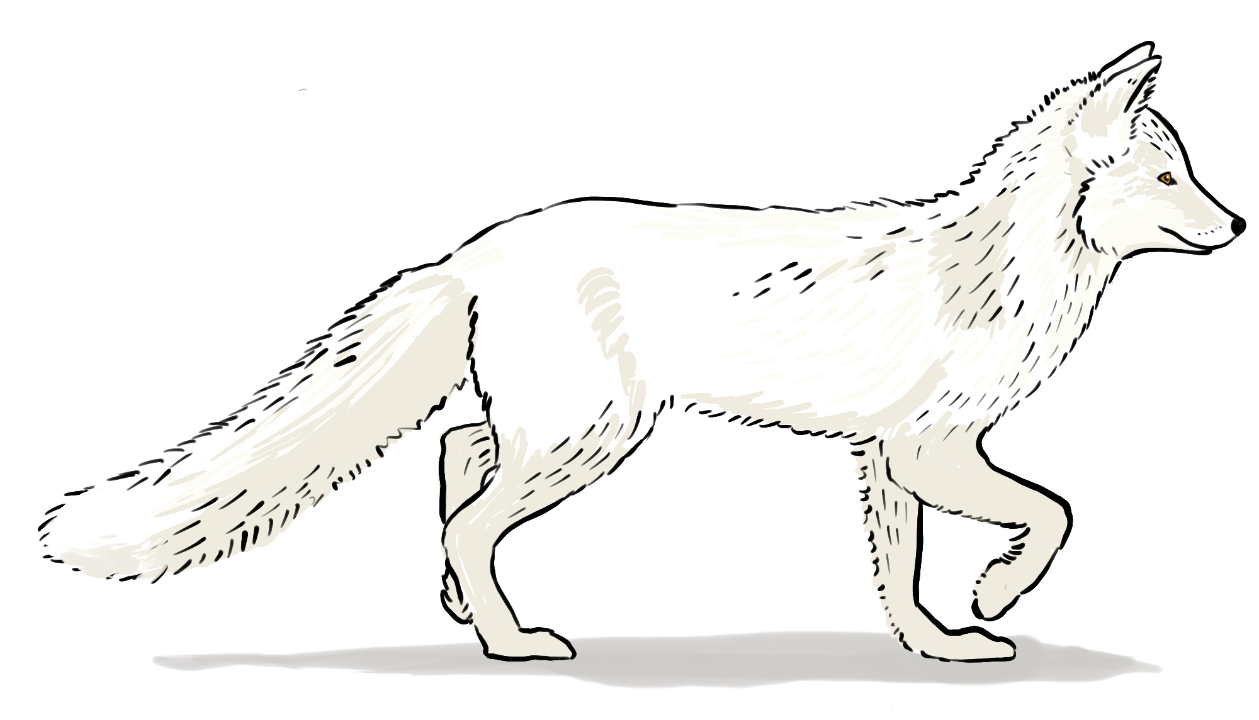
What animal is it?
Is it a dog? Is it a cat? Is it a fox?
What colour is it?
What does it eat?
Where does it live?
In the mountains?
In the forests?
In cities?

Slide 3
ACTIVITY 1
Read this file about foxes. What is incorrect?
Kingdom: vegetable, animal Type: reptile, herbivore, carnivore Habitat: mountain, forest, steppe, jungle Food: rodents, hares, birds, elephants Colour: red, green, grey Extra information: in danger of extinction in Argentina

Slide 4
ACTIVITY 2
Read the title for this legend. What do you think it is about?

Slide 5
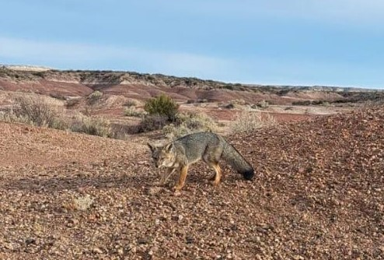
ACTIVITY 3
Circle the words you expect to find in ‘Why Fox is Red’.

Slide 6
ACTIVITY 4
Write the phrases in the box below next to the correct number.
Meat
The tip of his tail
Mother Goose
a hungry fox
The edge of the lake
Baby geese

Slide 7
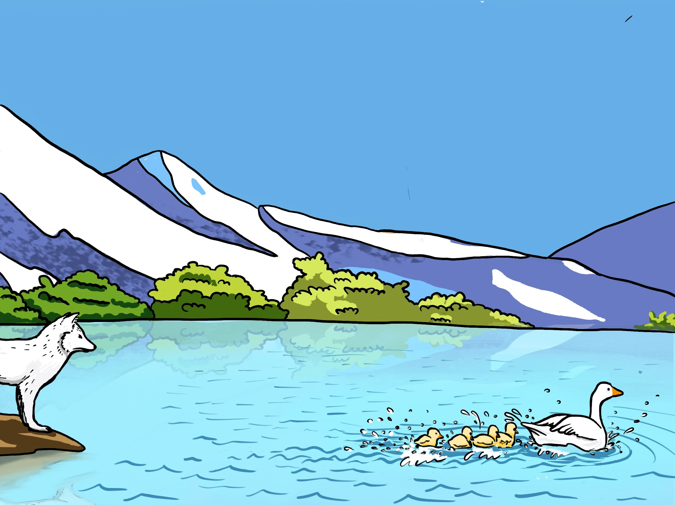
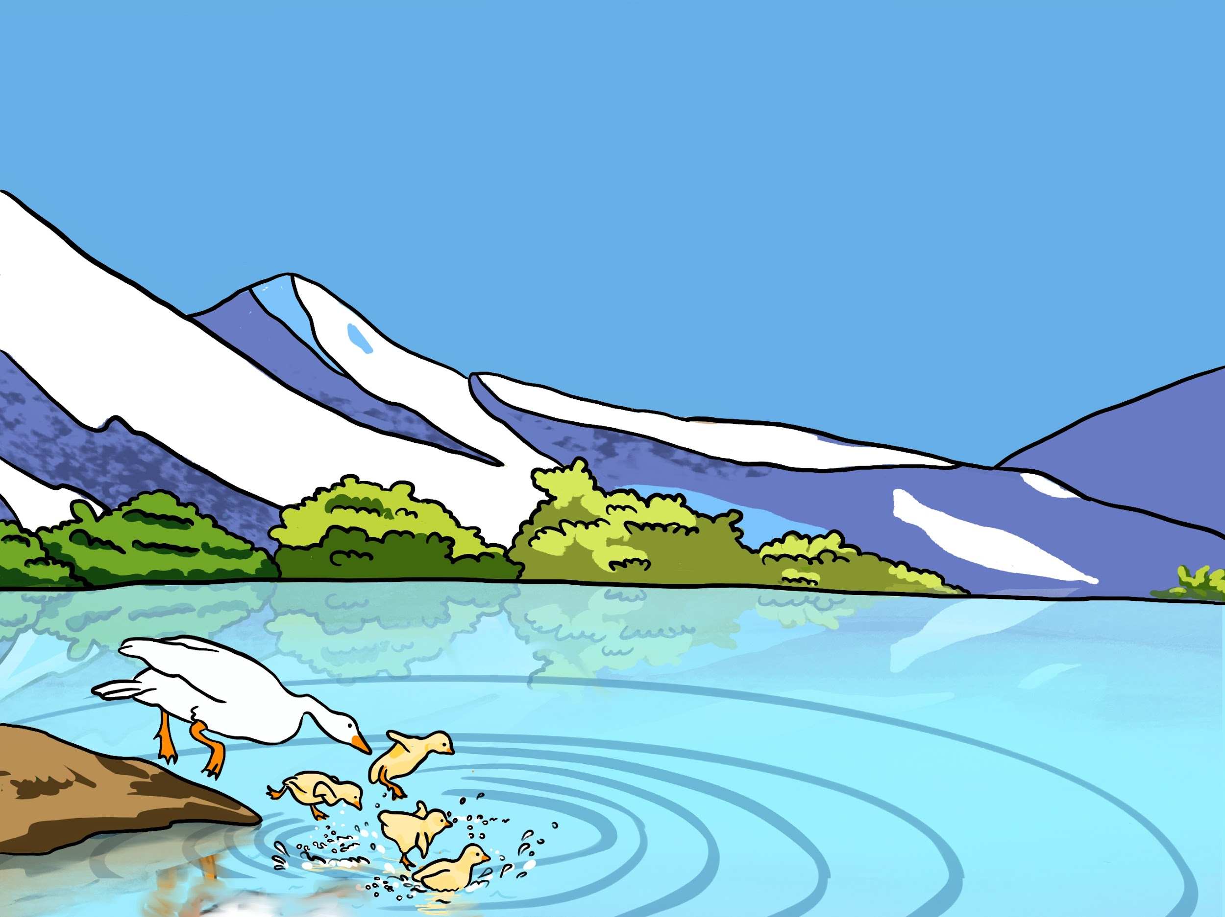
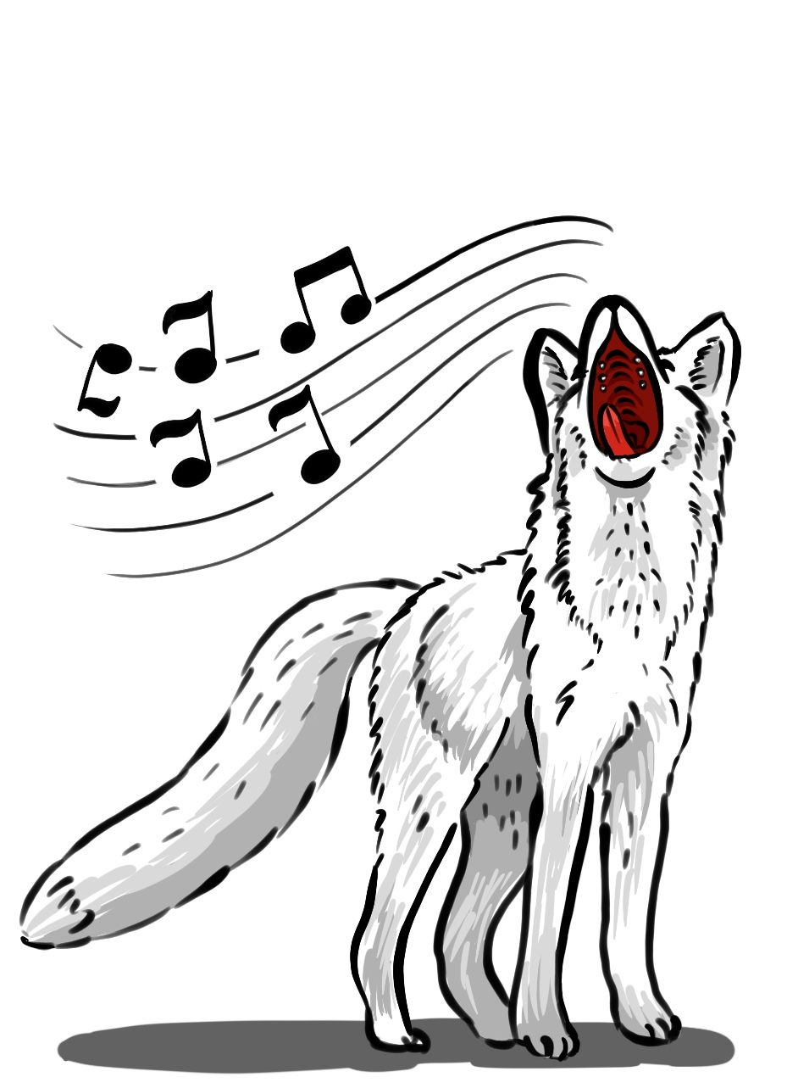
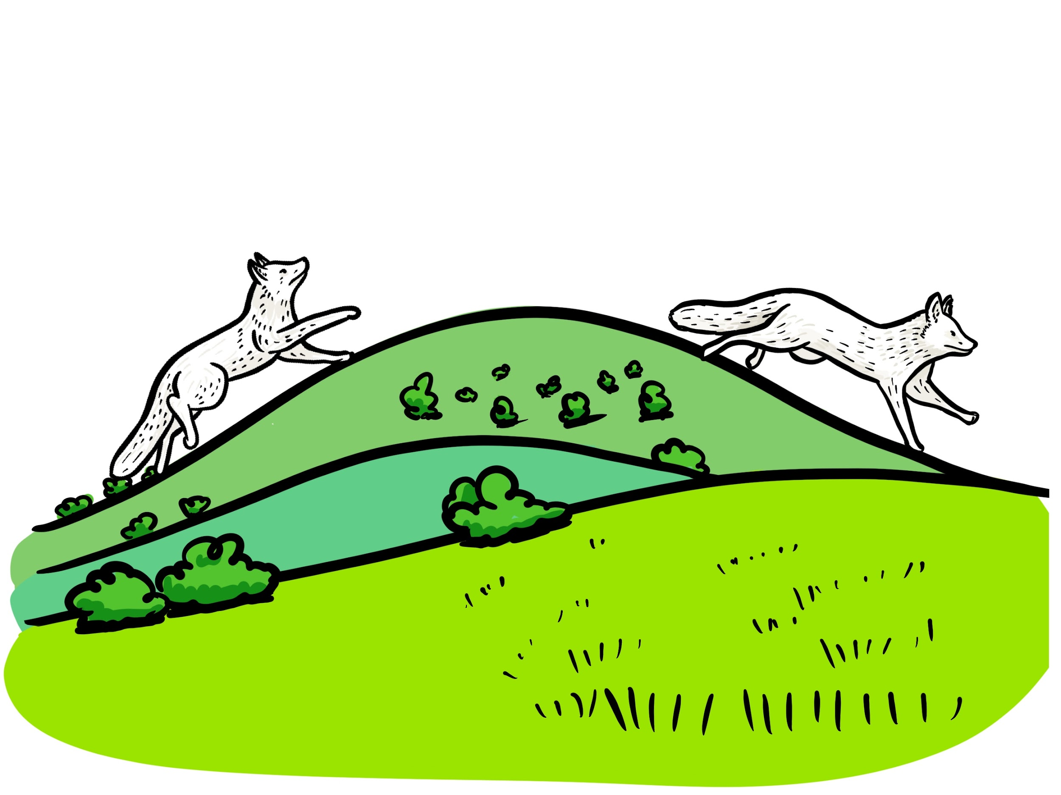
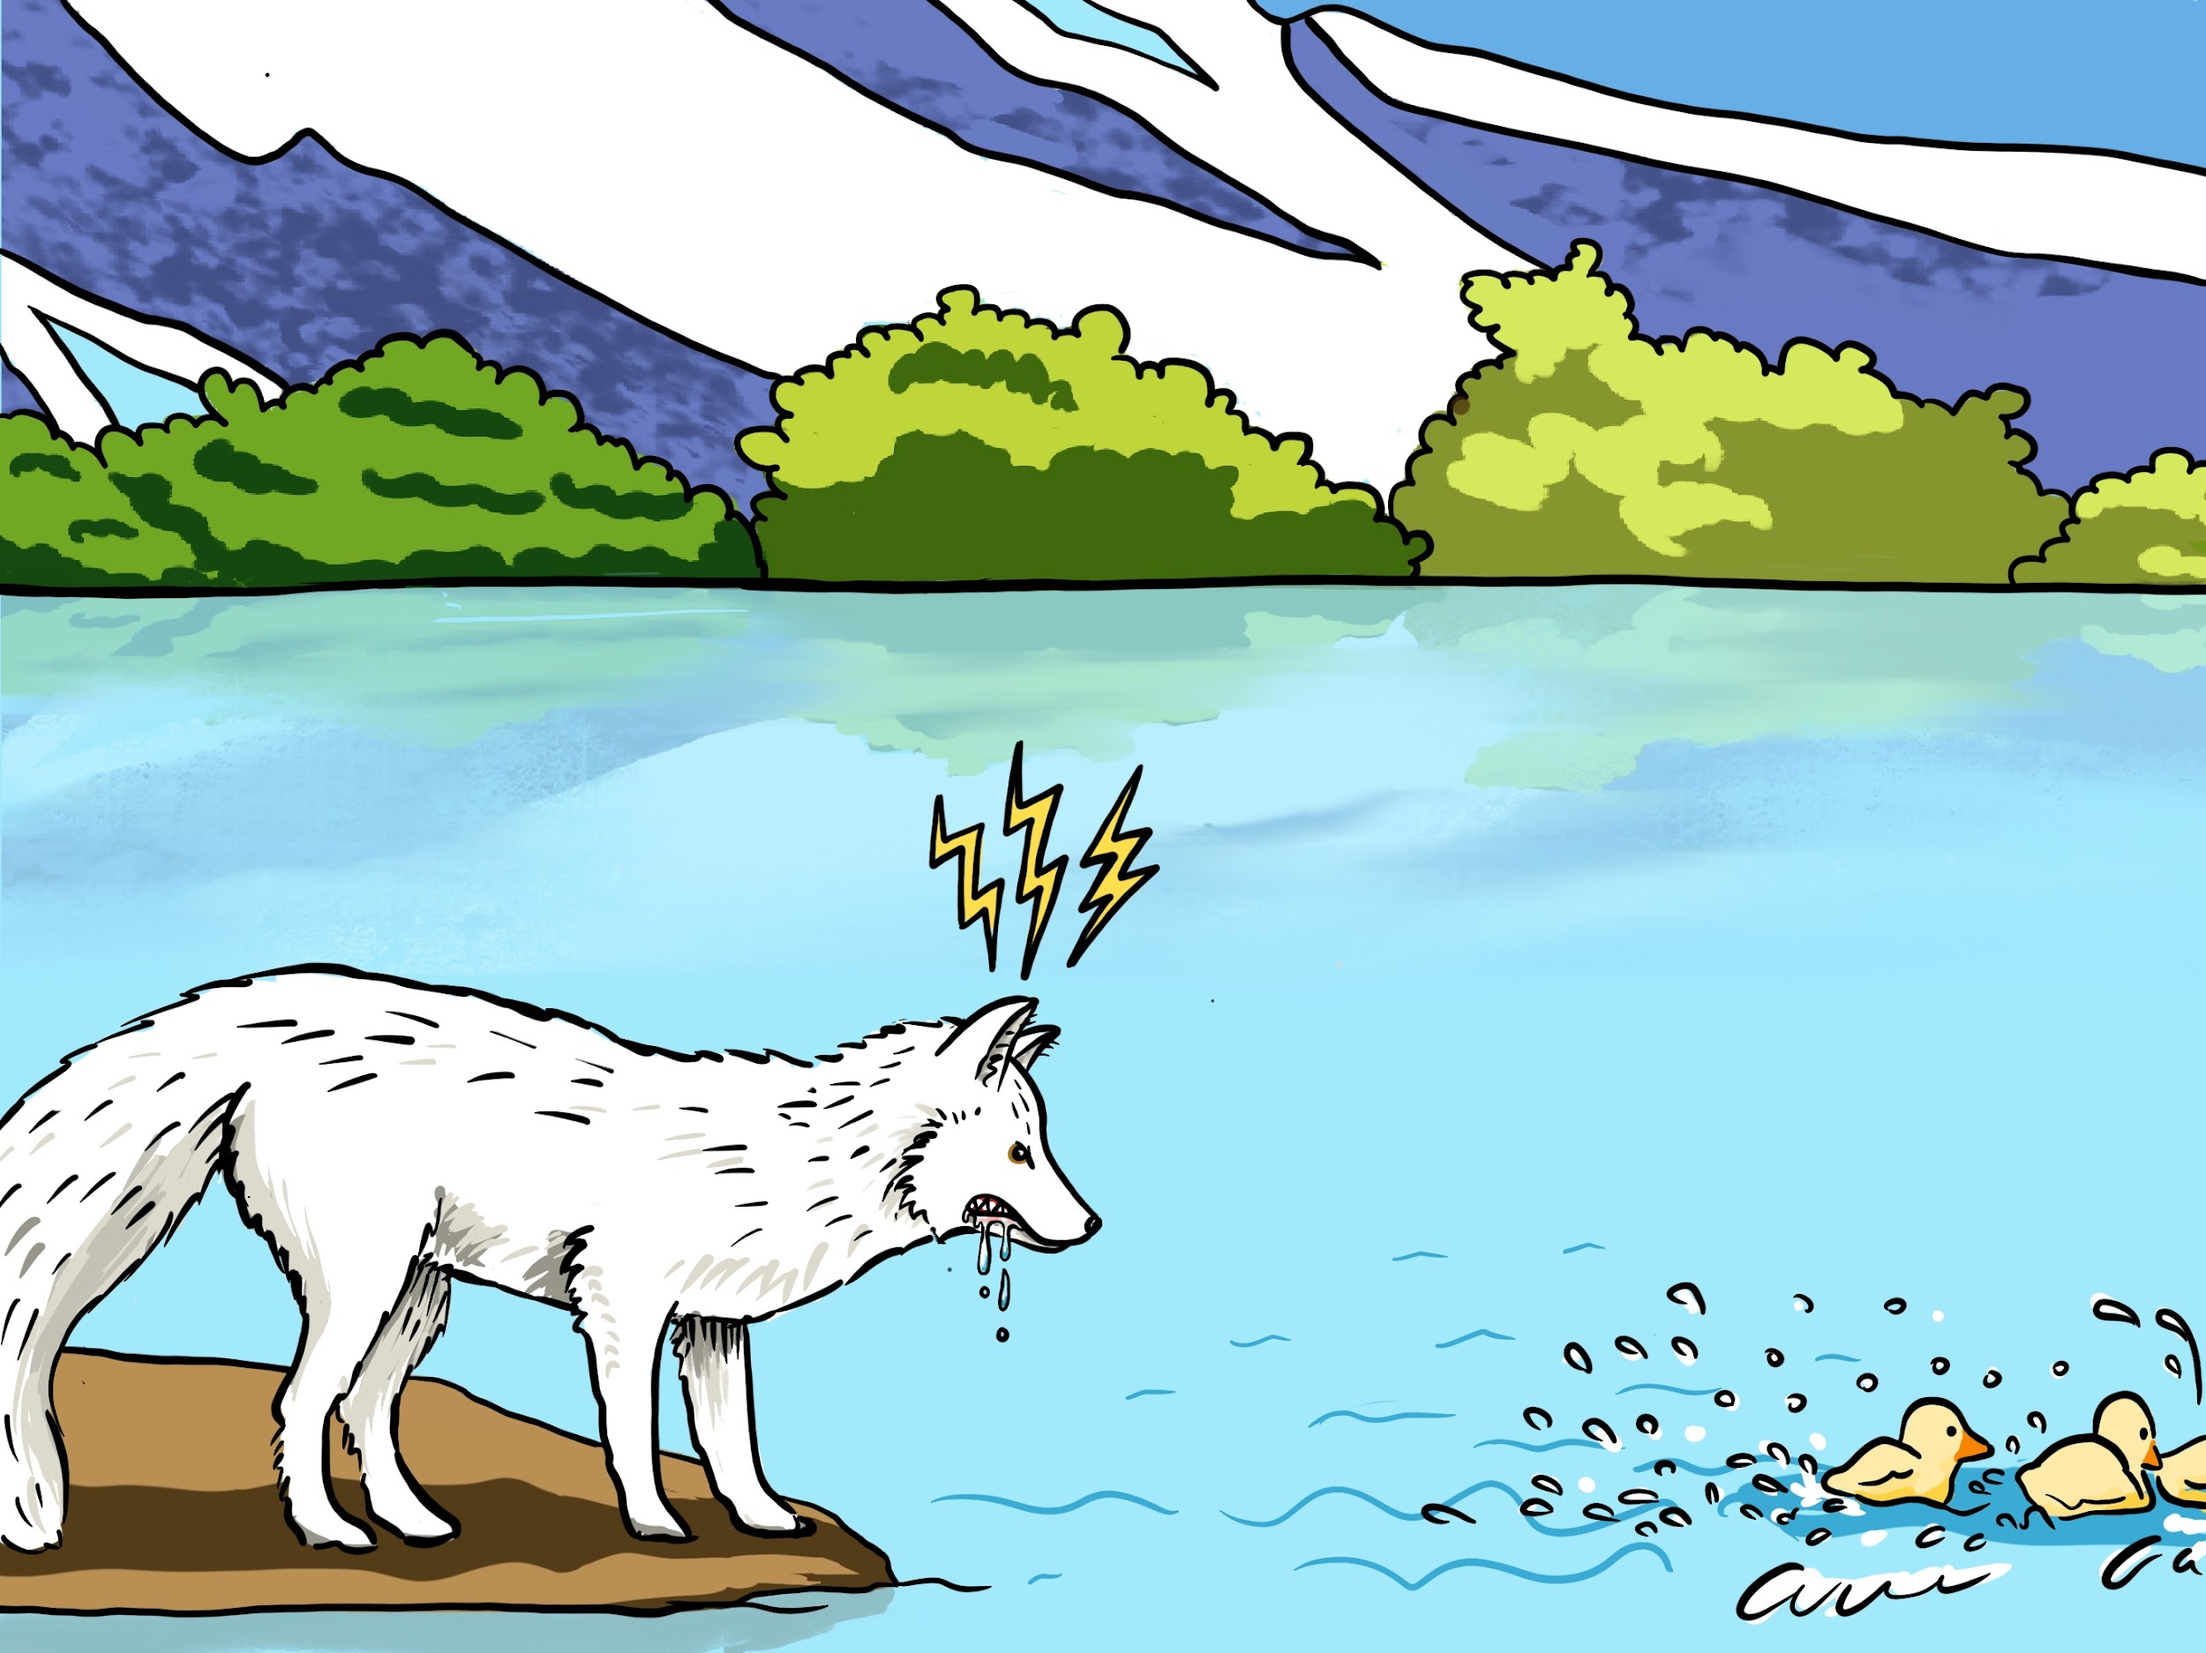
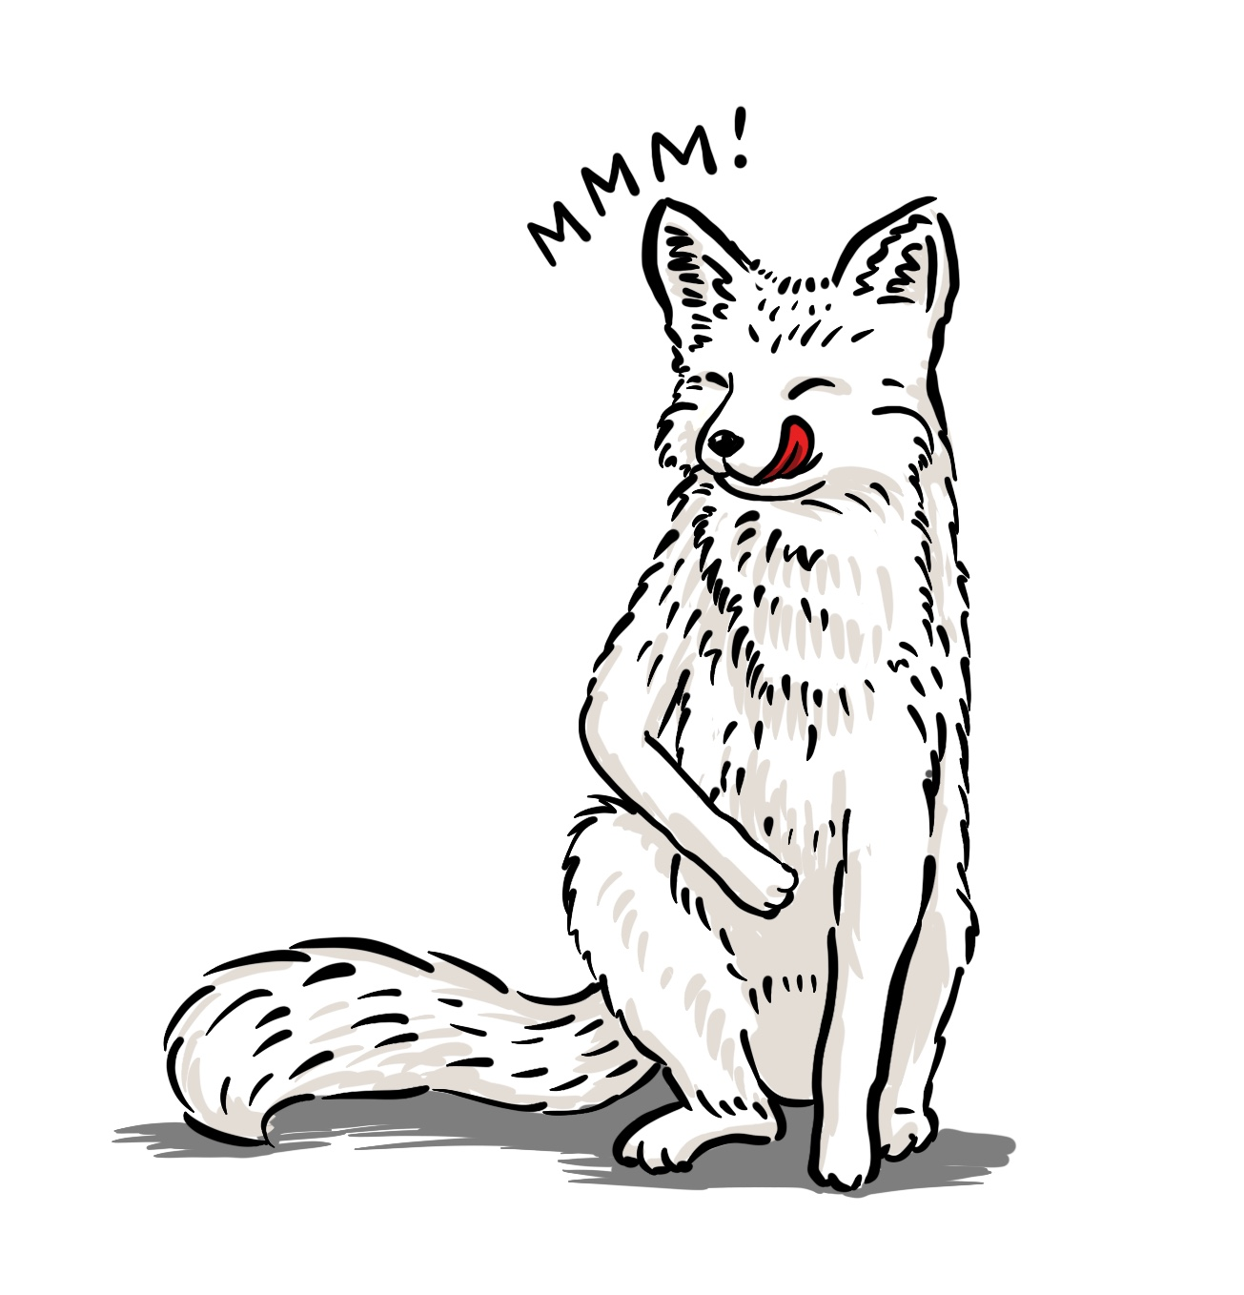
ACTIVITY 5A
Look at the pictures. Tick the actions you think the characters did.
swam farther and farther away
b. jumped into the water
d. grew angry
c. sang a song
f. couldn’t catch them
e. went uphill and downhill
g. ate
Notes:
poner link de la imagen de open access

Slide 8
ACTIVITY 6 COMPETITION TIME
Listen to the legend and circle the actions in activity 5 to check your predictions.
swam farther and farther away
b. jumped into the water
d. grew angry
c. sang a song
f. couldn’t catch them
e. went uphill and downhill
g. ate
Notes:
poner link de la imagen de open access

Slide 9
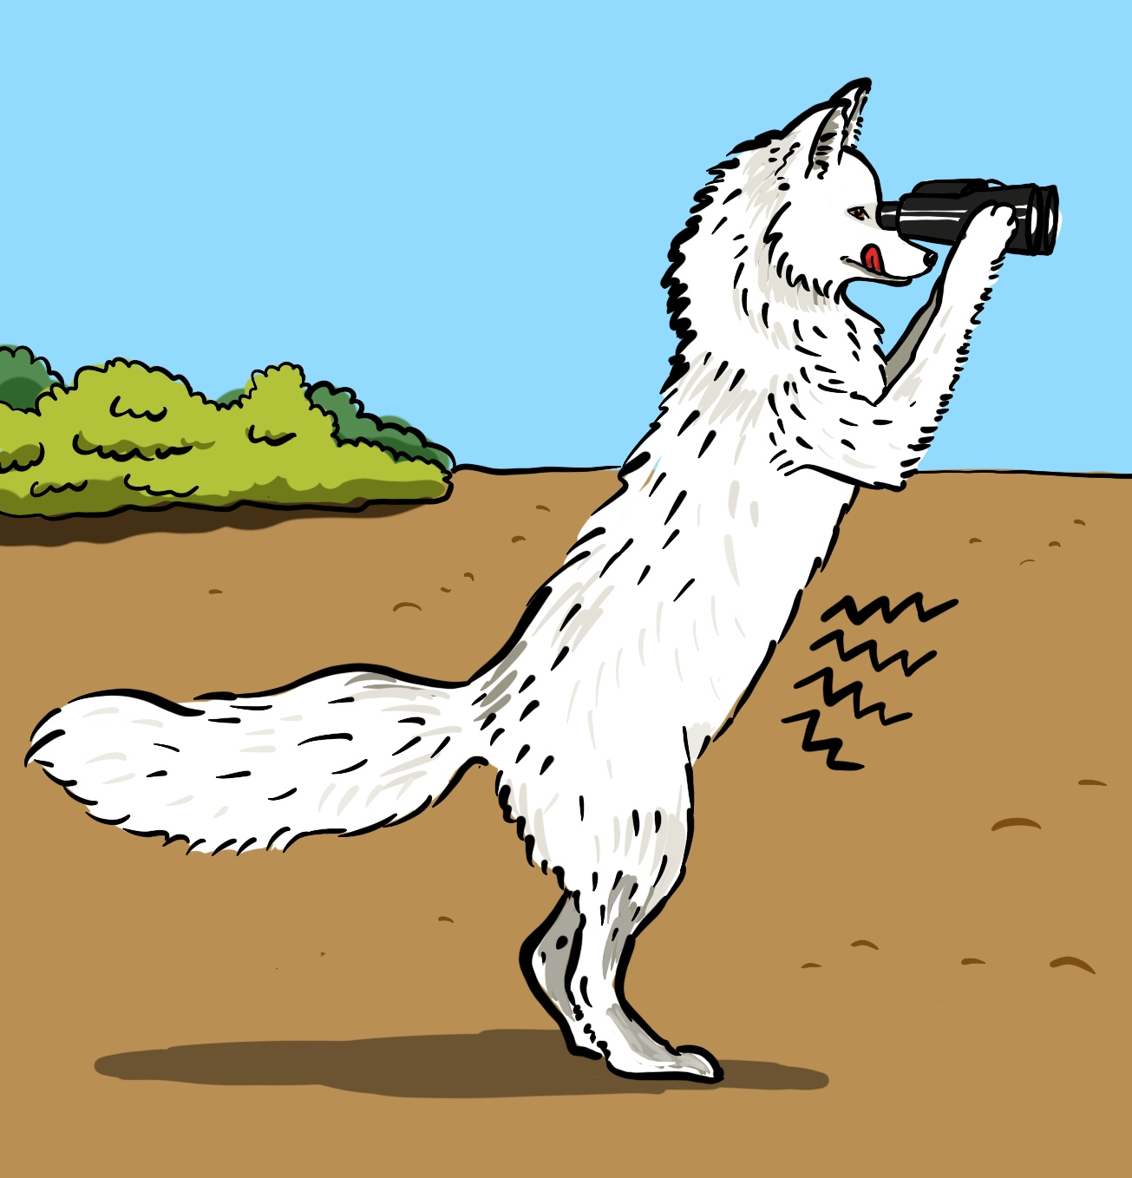
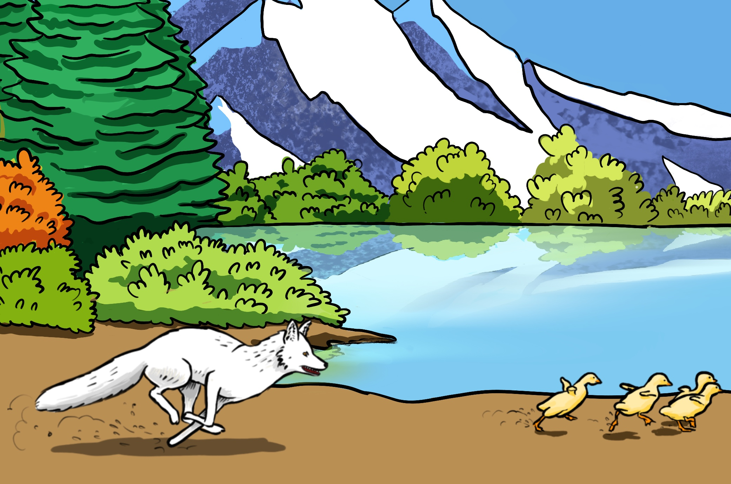
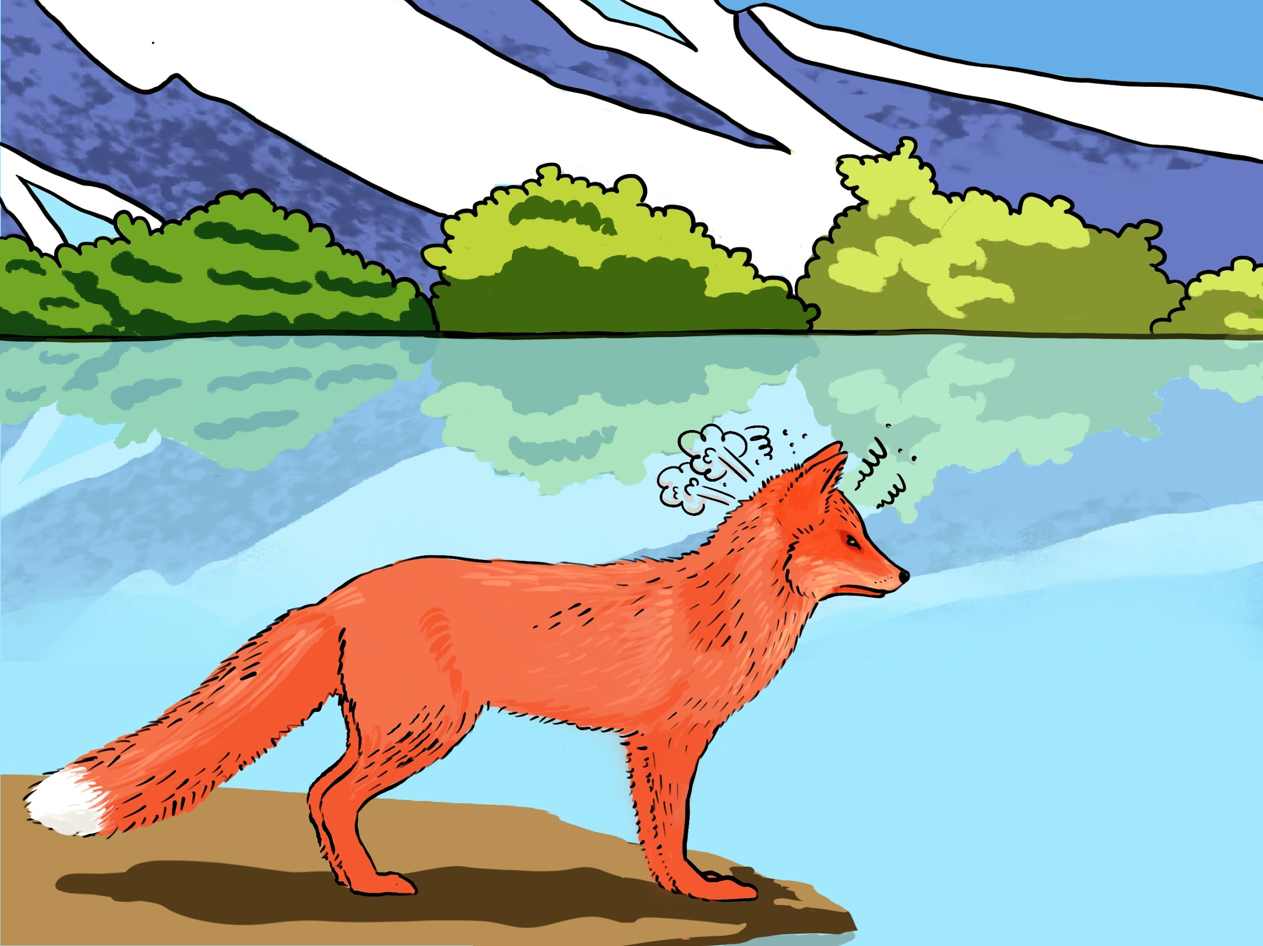
ACTIVITY 6 B
Listen and read ‘Why Fox is Red’ again. Underline those words you already know.
Why Fox is Red
¹Fox was very hungry. Loppita-loppitta-loppita went Fox, uphill, downhill, all around the countryside, looking for something to eat.
²At the edge of a lake, he saw mother goose with her babies. He ran after them and as he ran he sang: “I shall eat your tender meat before I go to sleep. I shall eat your tender meat before I go to sleep.”
³As soon as Fox ran towards the geese, they jumped into the water. Loppita-loppita-loppita went Fox, back and forth, back and forth, along the edge of the lake: the geese swam farther and farther away. Fox grew angrier and angrier.
⁴Soon the geese were floating in the middle of the lake. Fox howled: “Aaaahoooooohhhhhhh!” But he could not catch them. Fox was so angry, he turned red all over- except for the tip of his tail. And to this day, he has stayed that way. So it is told.

Slide 10
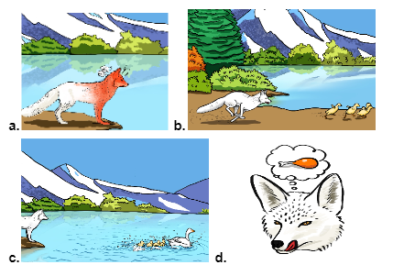
ACTIVITY 7 A
Listen to and read the legend and order the pictures according to the story.
D
....................
....................
.....................
......................
B
C
A

Slide 11
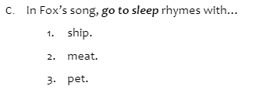
ACTIVITY 7 B
Choose the best option.

Slide 12
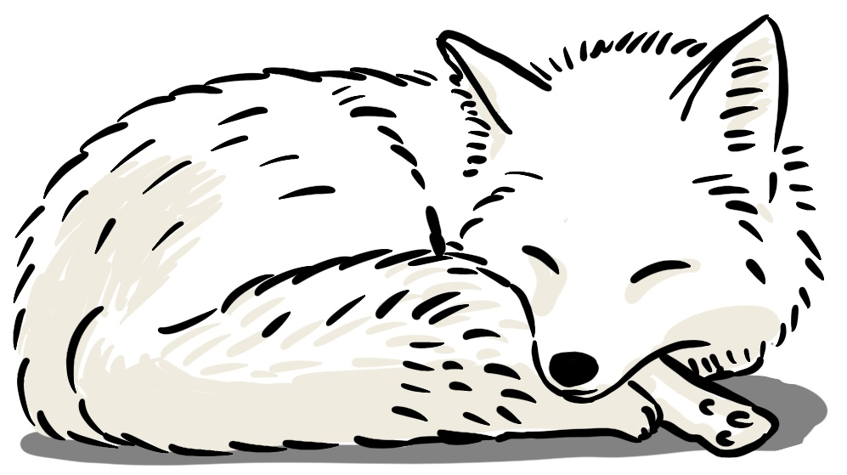
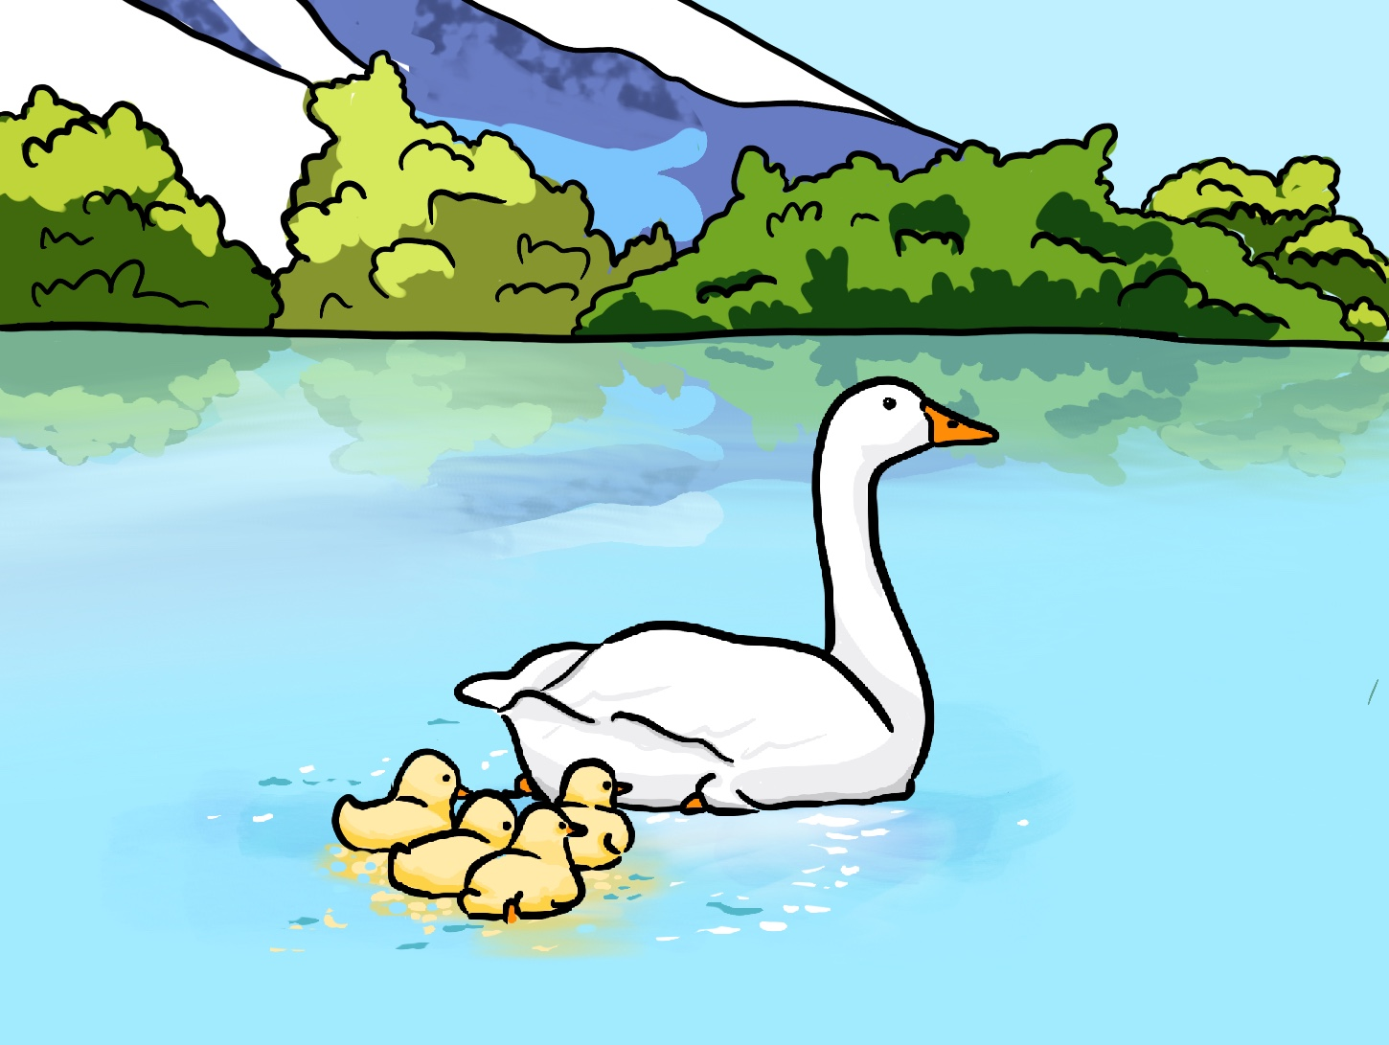
ACTIVITY 8
Find phrases for the pictures below in the legend. Write them down.
go to sleep
b. turned red all over
c. ran after them
d. to this day
e. in the middle of the lake
f. looking for something to eat

Slide 13
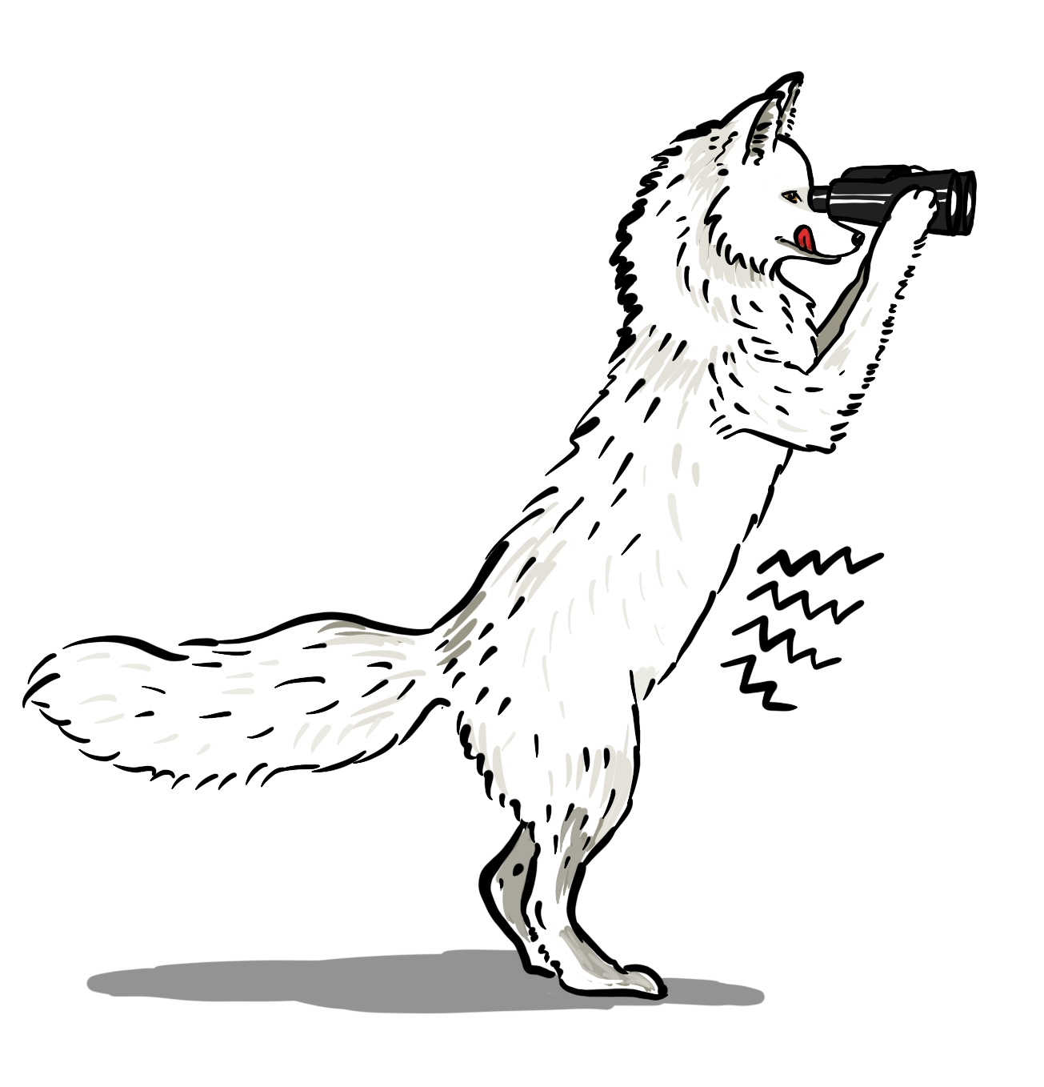
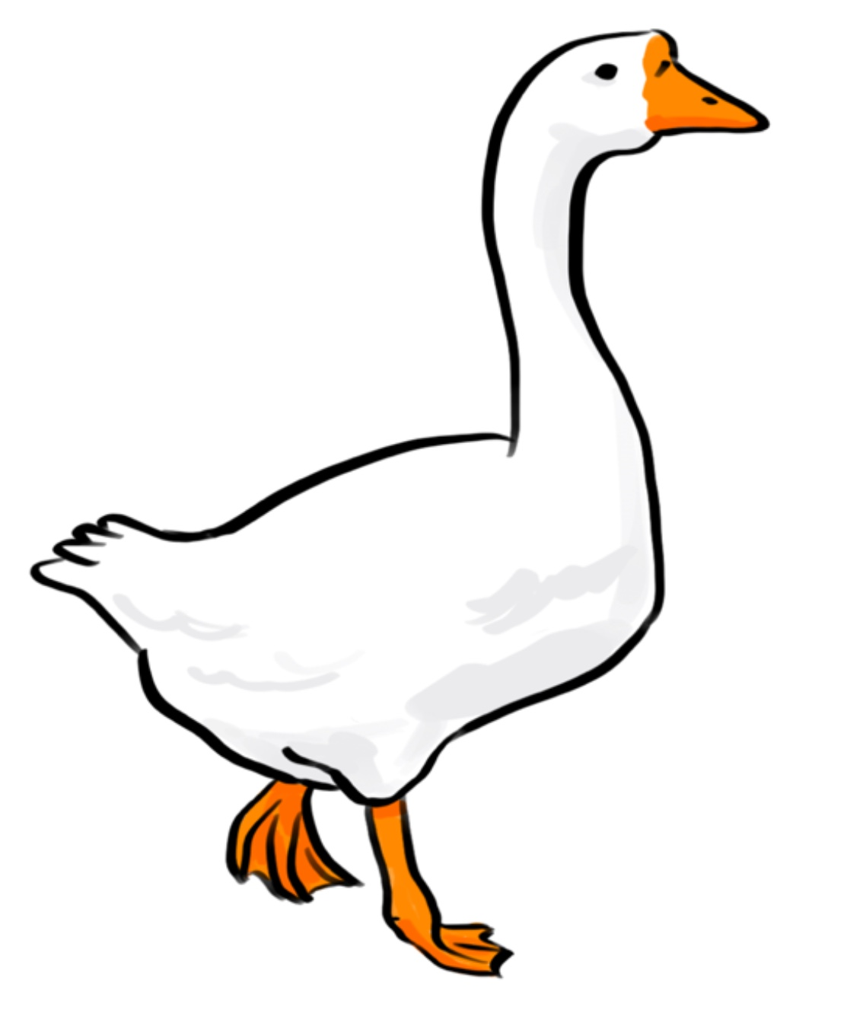
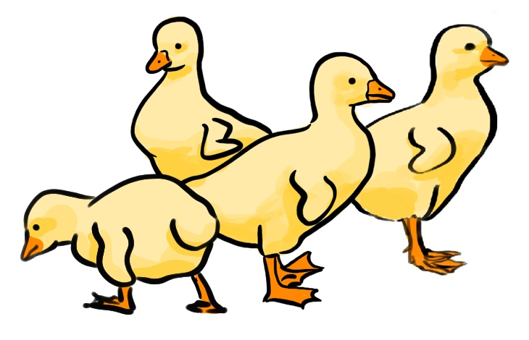
ACTIVITY 9A
Use arrows to match the characters with the actions. Circle the idea that is not part of the story.
ACTIONS
(a) …ran after the geese.
(b) …was looking for something to eat.
Fox
(c) …has stayed red to this day.
(d)…sang: “I shall eat your tender meat before I go to sleep”.
(e)…were floating in the middle of the lake.
(f)…travelled far.
Mother goose with her babies
(g)…..turned red all over.

Slide 14
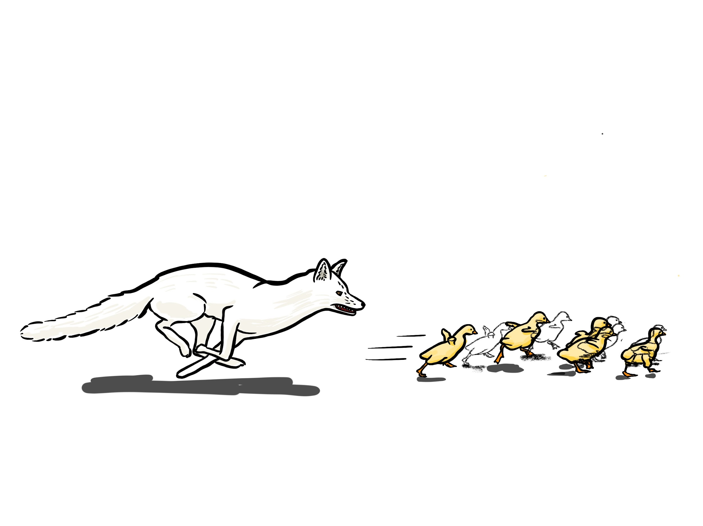
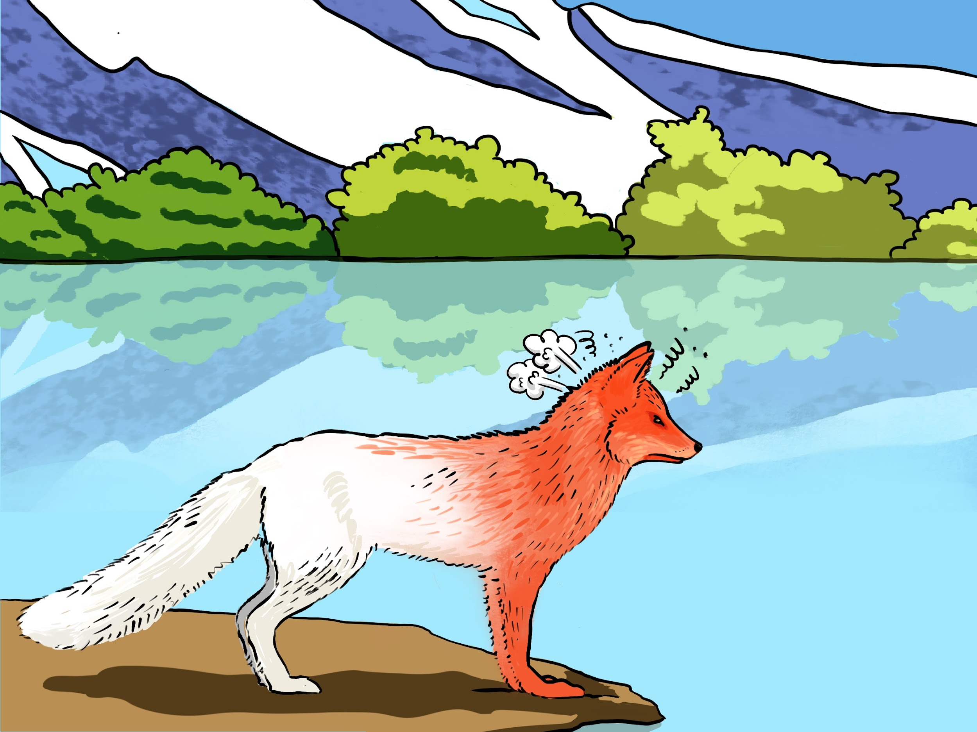
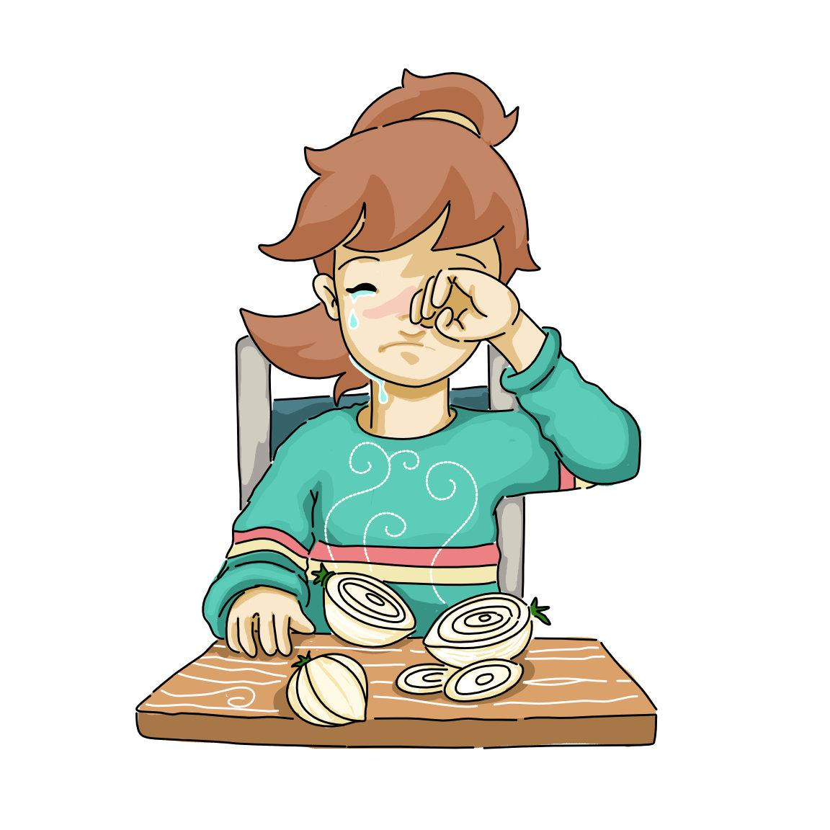
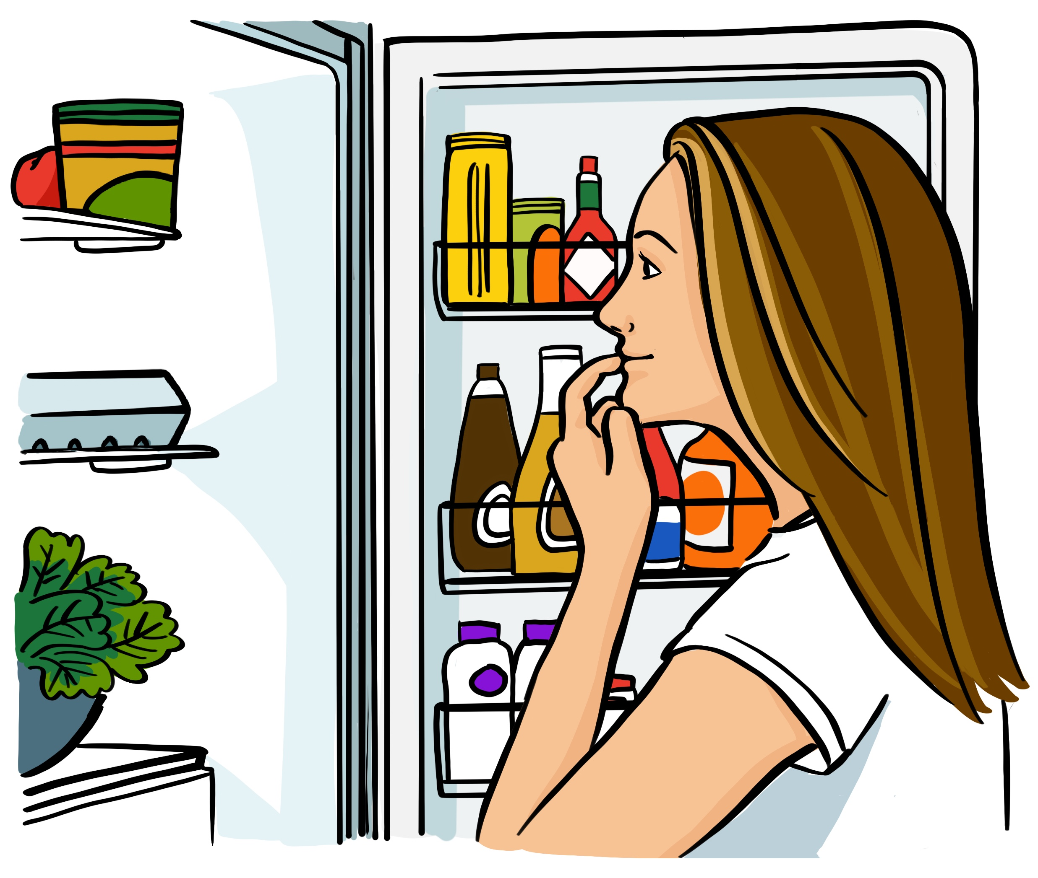
ACTIVITY 10
Cross out the extra word in these phrases. Which phrase belongs to “Remember Me”?
a.
ran | turned | after | the geese
b.
make | go | to | sleep
c.
turned | red | green | all | over
d.
make | you | close | cry
looking | singing | for | something | to | eat
e.
f.
to | this | one | day
g.
in | the | edge | middle | of | the lake

Slide 15
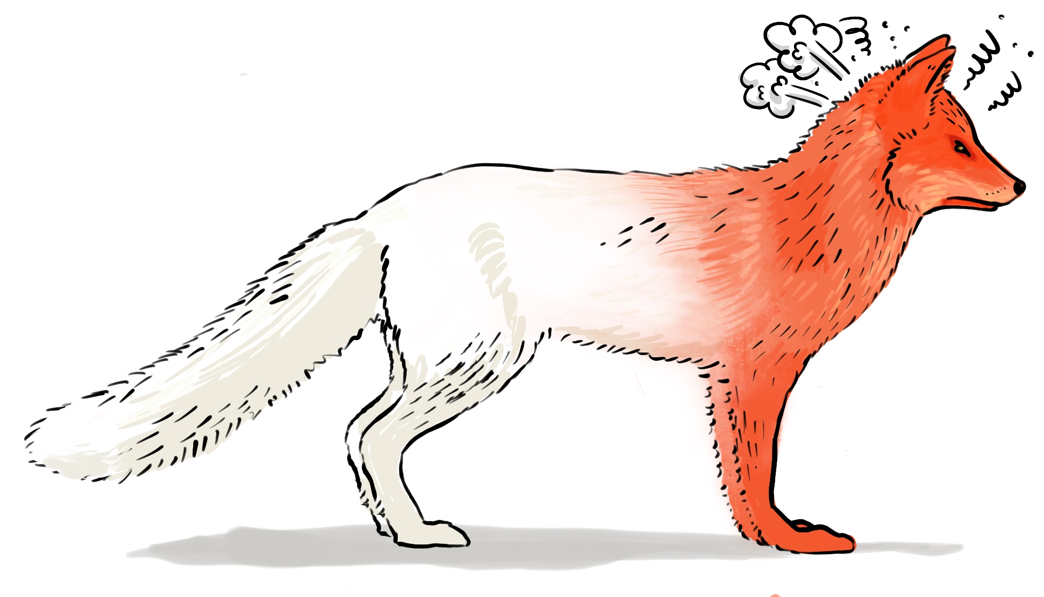
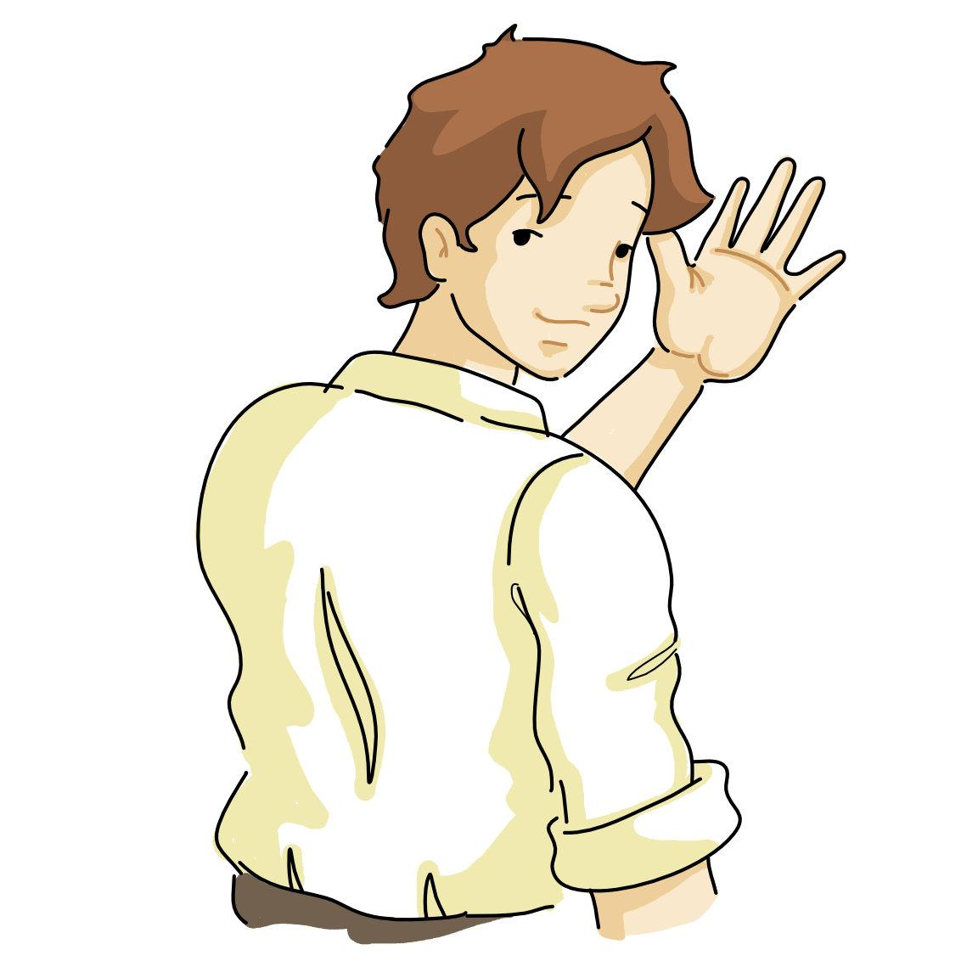
ACTIVITY 11
Look at the pictures. Write the missing phrases in these ideas.
looking for something to eat.
A.Fox was hungry. He was
B. The geese were floating lake.
in the middle of the
go to sleep
C. Fox said: “I’ll eat your meat before I .”
ran after
D. Fox the geese.
turned red all over.
E. Fox was angry and
to this day
F. And Fox has stayed that way.
goodbye"
G. Fox said to his lunch.

Slide 16
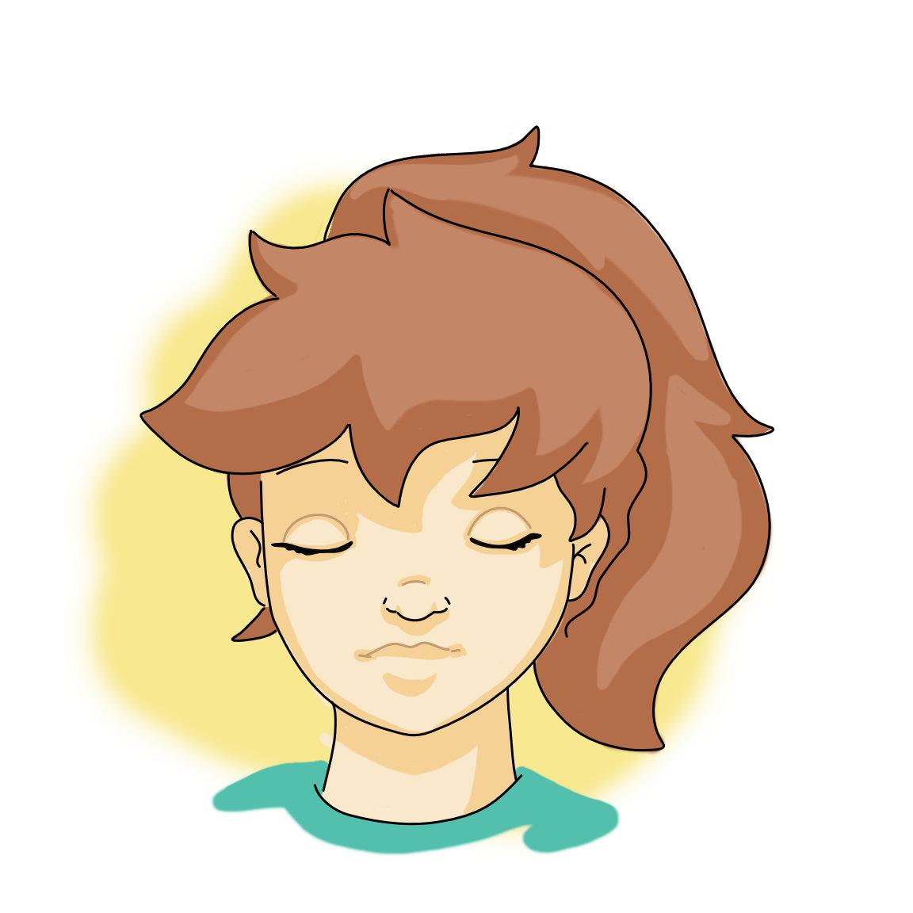
ACTIVITY 12
Let’s see how much you can remember. Write the missing word and circle the right image. Which idea is not part of the legend?
Fox was for something to eat.
goodbye
4. Fox said __________to his lunch._______ .
looking
A
B
A
B
middle
5. The geese were floating in the of the lake.
ran
2. Fox after Mother goose and her babies
A
B
A
B
turned
6. Fox red all over.
3. Fox said: “I’ll eat your meat before I to sleep.”
go
A
B
day
7. To this , Fox has stayed red.
A
B
A
B

Slide 17
ACTIVITY 13 A
Find a phrase in the phrase soup for each of the images below.
Do all of them belong to this legend?
ACTIVITY 13 B
Write the phrases you’ve found here.
a
Y | O | M | A | K | E | Y | O | U | C | R | Y | E | R | A | R
H | E | M | T | R | A | V | E | L | F | A | R | Z | F | E | G
S | J | L | G | O | T | O | S | L | E | E | P | F | D | O | E
A | G | U | T | O | T | H | I | S | D | A | Y | H | A | T | J
F | E | S | A | Y | G | O | O | D | B | Y | E | I | S | G | K
T | U | R | N | E | D | R | E | D | A | L | L | O | V | E | R
J | I | N | T | H | E | M | I | D | D | L | E | O | F | O | F
O | Y | R | A | N | A | F | T | E | R | T | H | E | M | T | V
Turned red all over
h.
i.
b
looking for something to eat
say goodbye
c
go to sleep
make you cry
ran after them
h
d
f
in the middle of (the lake)
run after
i
g
travel far
e

Slide 18
After Reading
ACTIVITY 14 THINKING TIME.
In pairs, discuss:
c- What is the worst we can do when we turn red?
a- Fox turned red. Why? How?
Everybody admired him.
He changed colour.
He was happy.
He got angry.
He made friends with the geese.
He lost his friends.
He had nothing to eat.
d- What is the best we can do when we turn red?
e- Do you remember a situation when you turned red? What happened?
I remember when I ……………………………. and I turned red.
b- What can we learn from this legend?

Slide 19
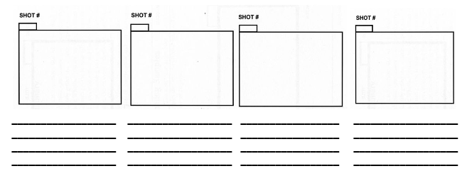
ACTIVITY 15 A
Work in groups of three. Choose one of the following characters. Use the storyboard below to write a cartoon story.
Use the phrases in the box.
go to sleep - in the middle of (the lake)-
make (you) cry - ran after (the geese)-
say goodbye - to this day
turned red all over-
was looking for (something) to eat

Slide 20
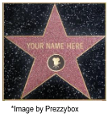
ACTIVITY 15 B
Make a video role of your story. Use any of the following apps:
TikTok, Dubsmash,
Byte
Triller
Funimate
Chingari.
ACTIVITY 15C
Be ready to share it with your classmates, friends and family!

Slide 21
Audio File
https://bibliotecadelenguas.uncoma.edu.ar/files/original/ecd98aa9b563c50145ac67f15bda7454.mp4

