Slide 1

Hope
for tomorrow

Slide 2

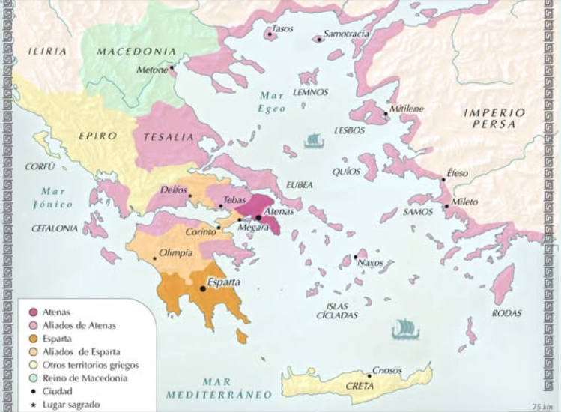
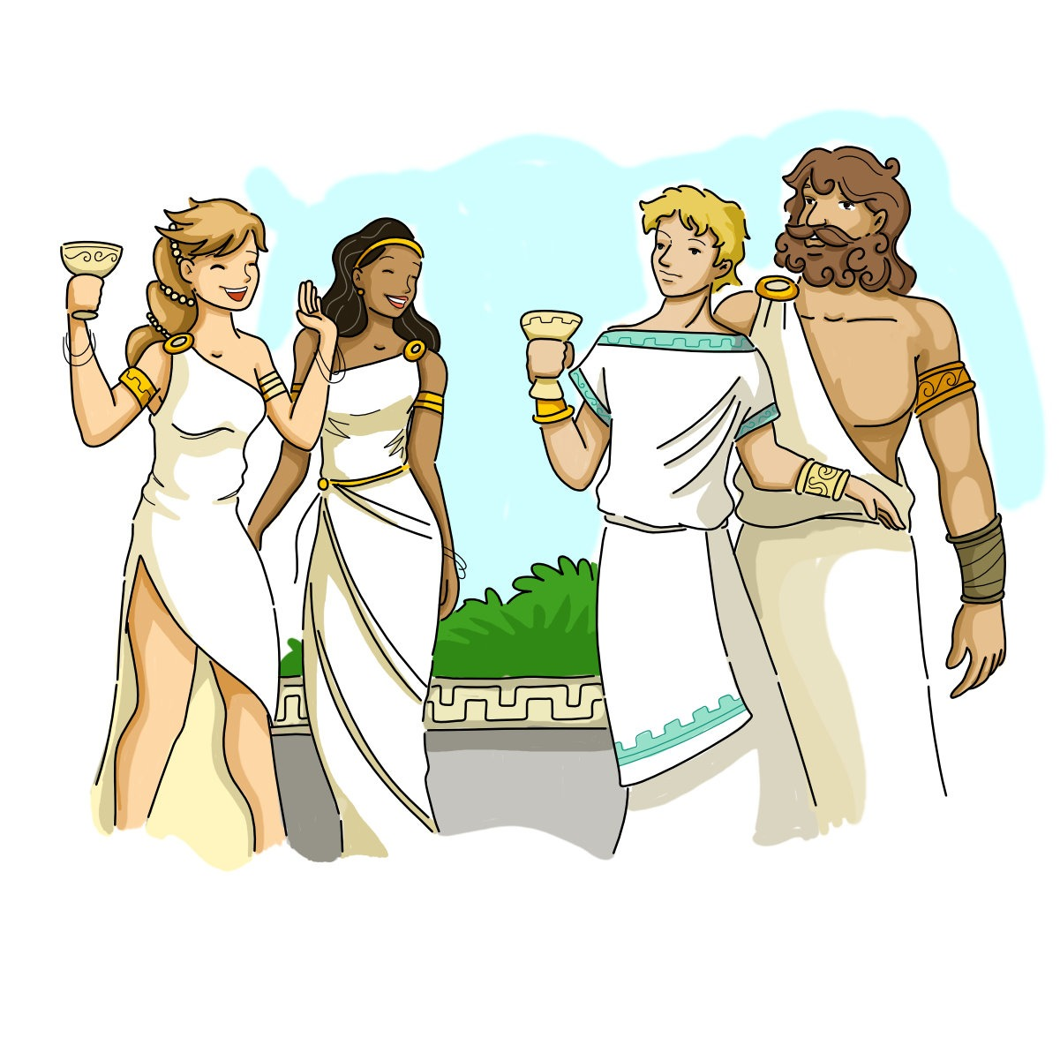
Greek Myths
Hercules
Zeus
the Titans
Mount Olympus
Pandora

Slide 3


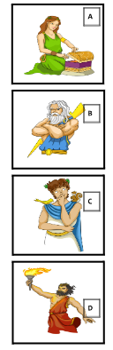
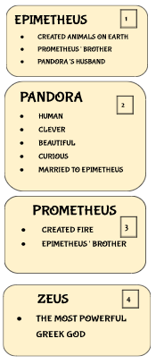
ACTIVITY 1
Match the following characters in this myth with their descriptions.

Slide 4

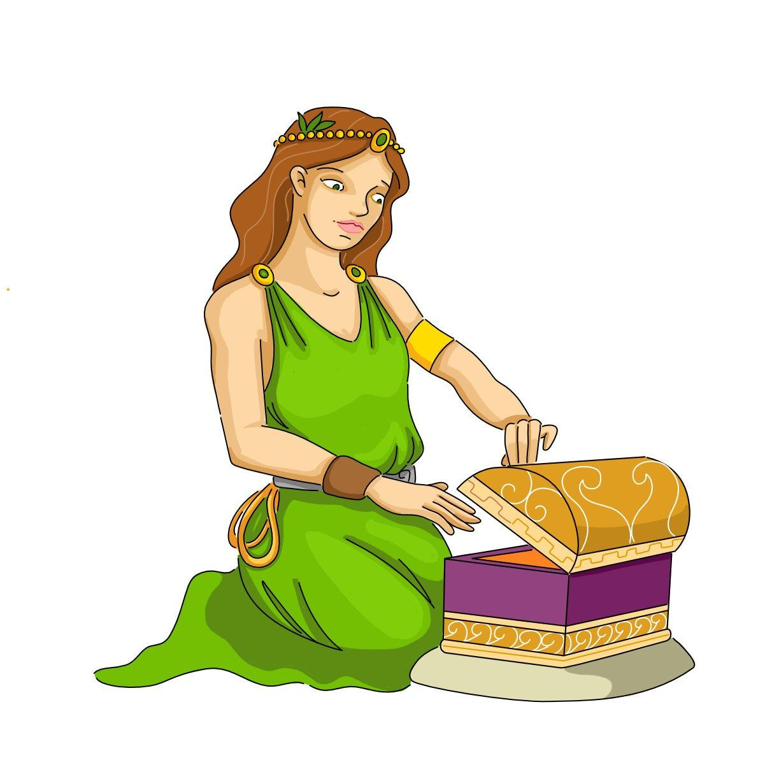
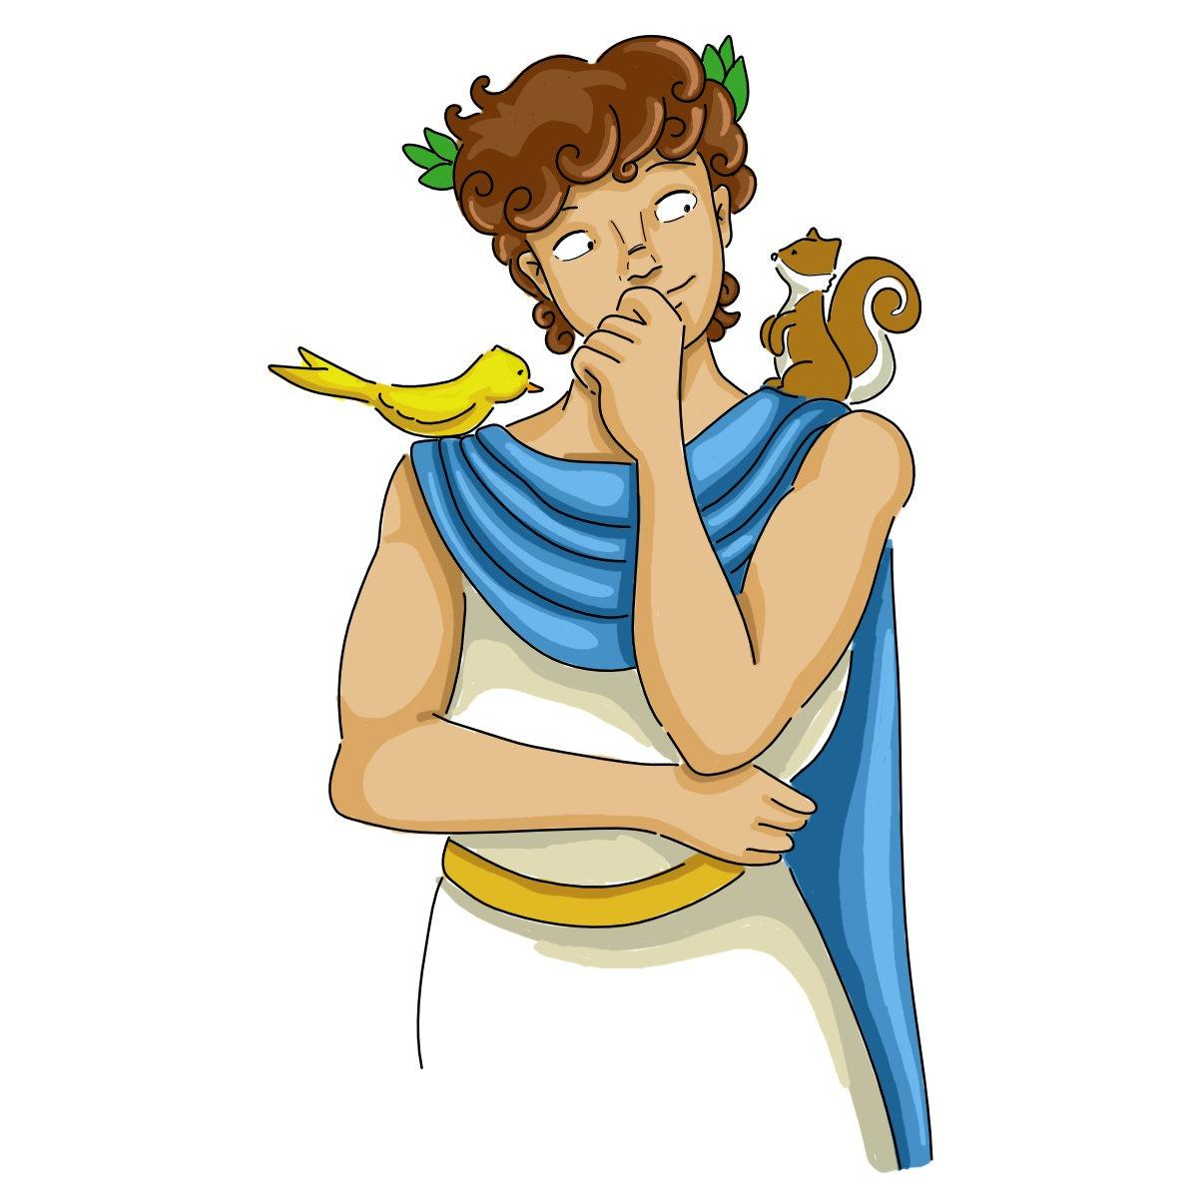
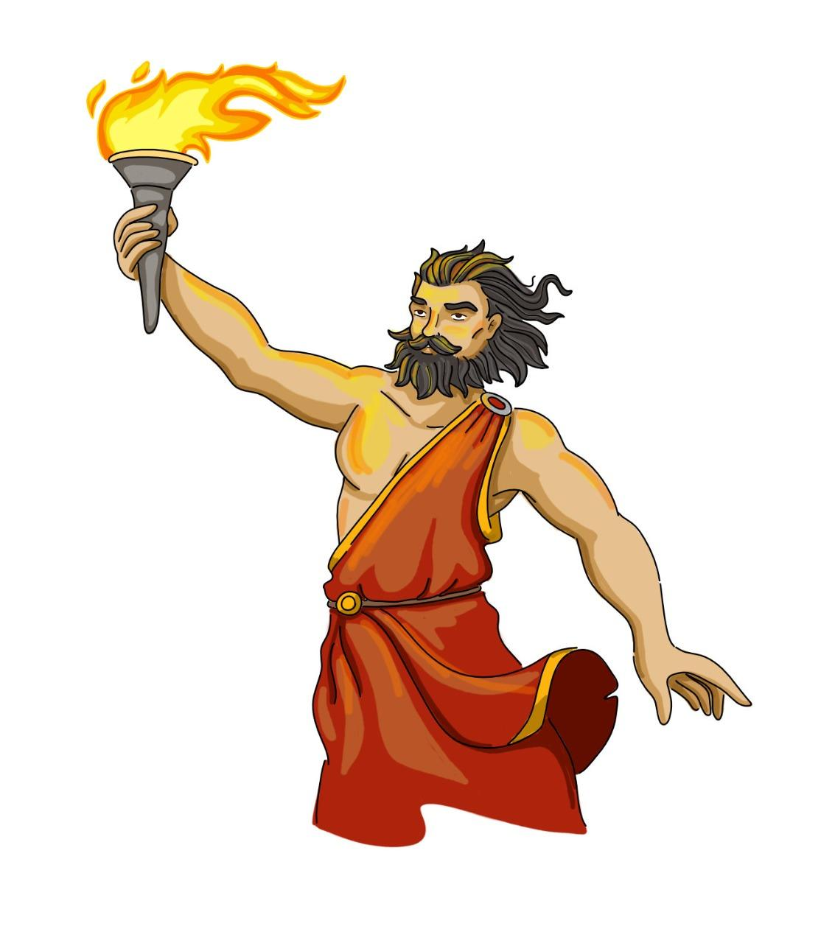
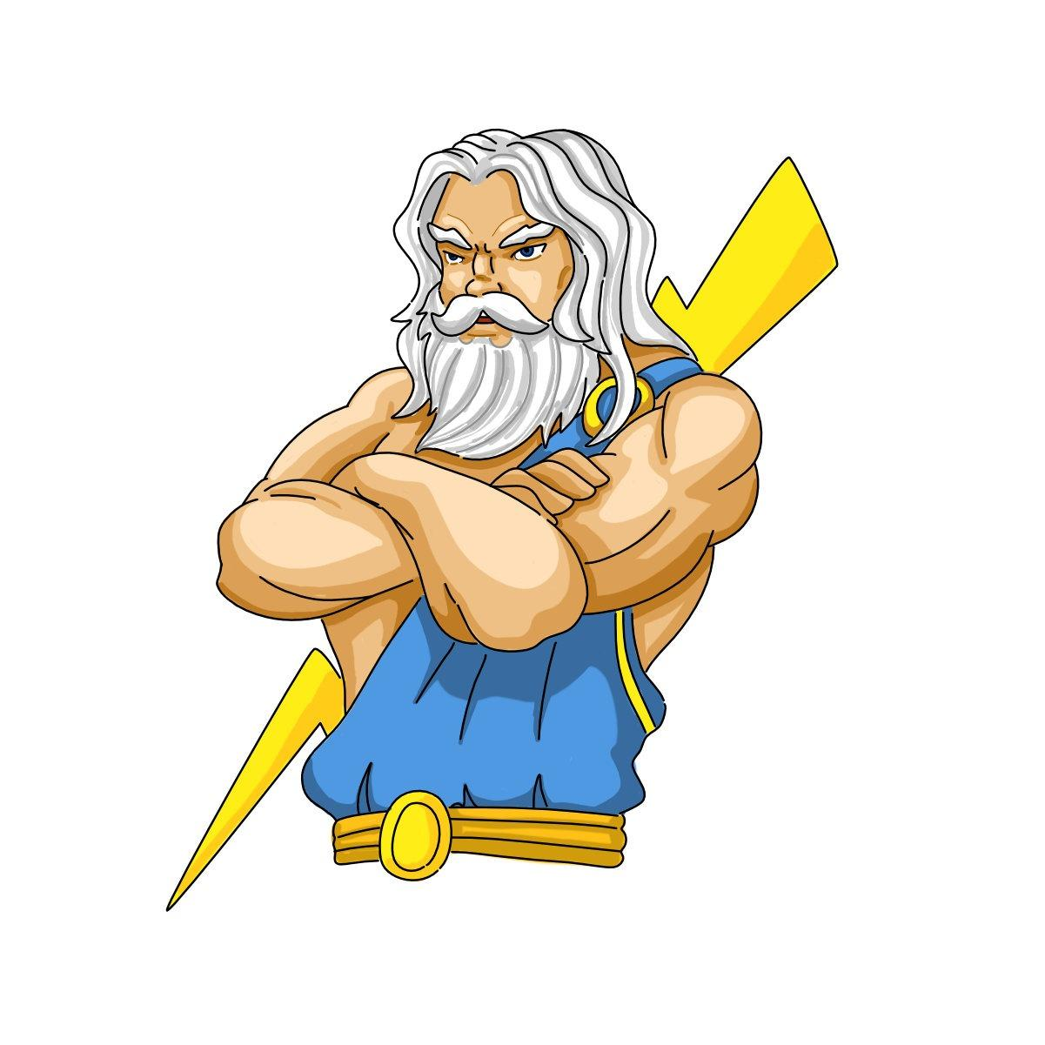
Epimetheus created fire. ………
Pandora is Epimetheus’ wife. ……….
Zeus is human. ………
Prometheus is a very curious person. ……….
F
Prometheus
T
F
a god.
Pandora
F

Slide 5
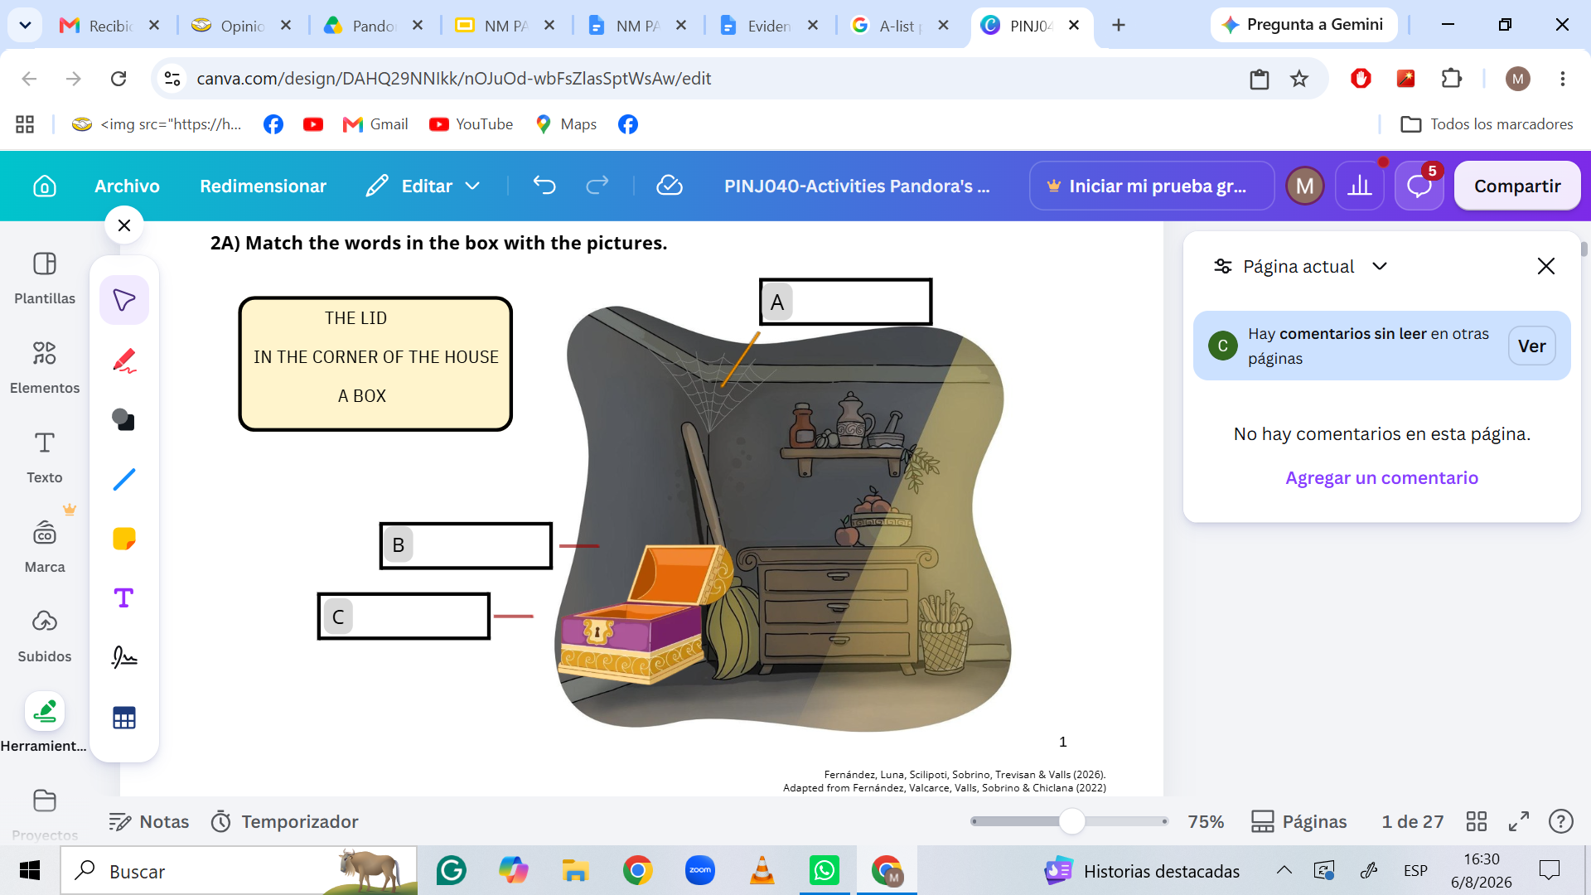
IN THE CORNER OF THE HOUSE
THE LID
A BOX

Slide 6
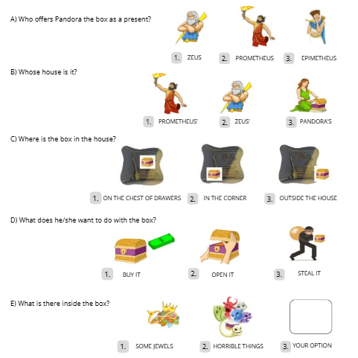

Slide 7
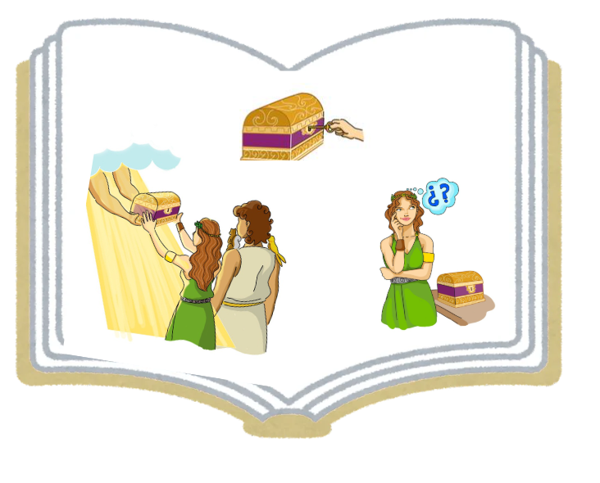

Slide 8
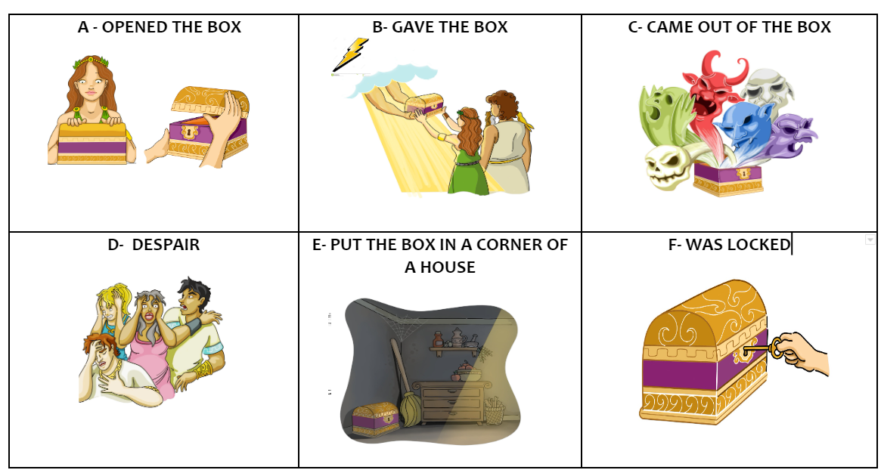
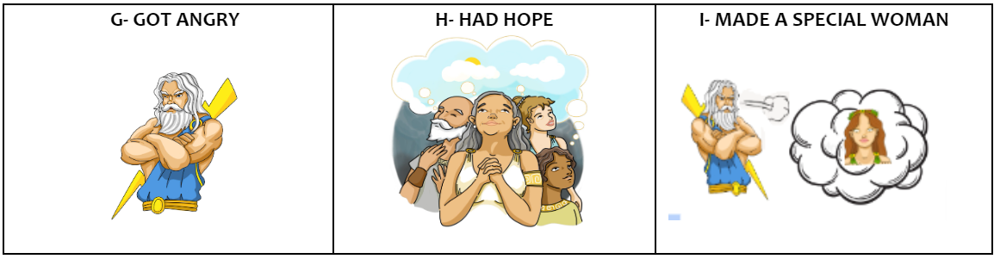

Slide 9


Slide 11

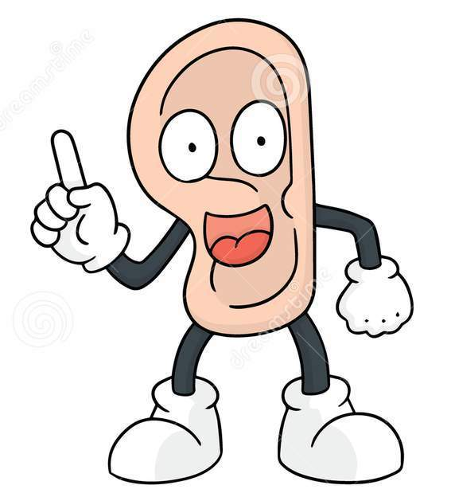

Listen to the myth…
… and write a cross

Slide 12


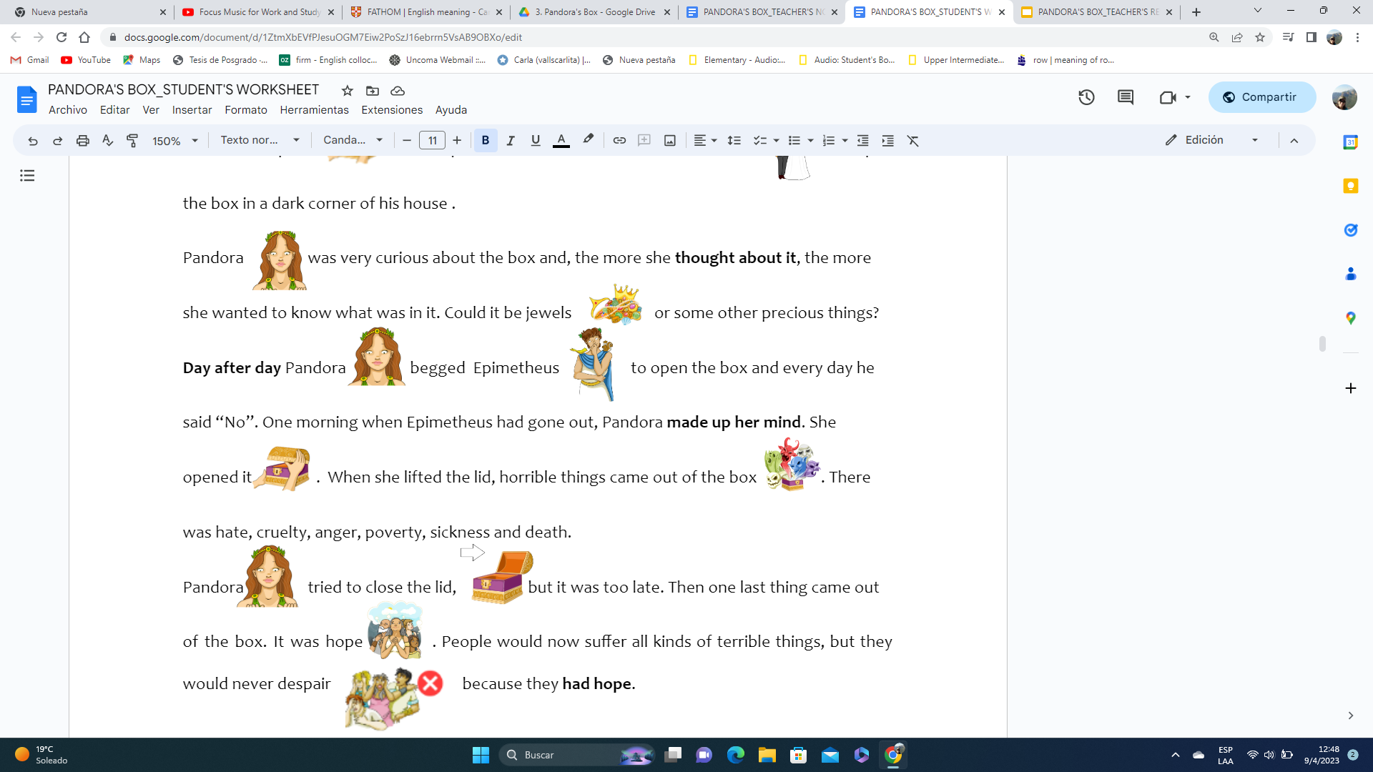
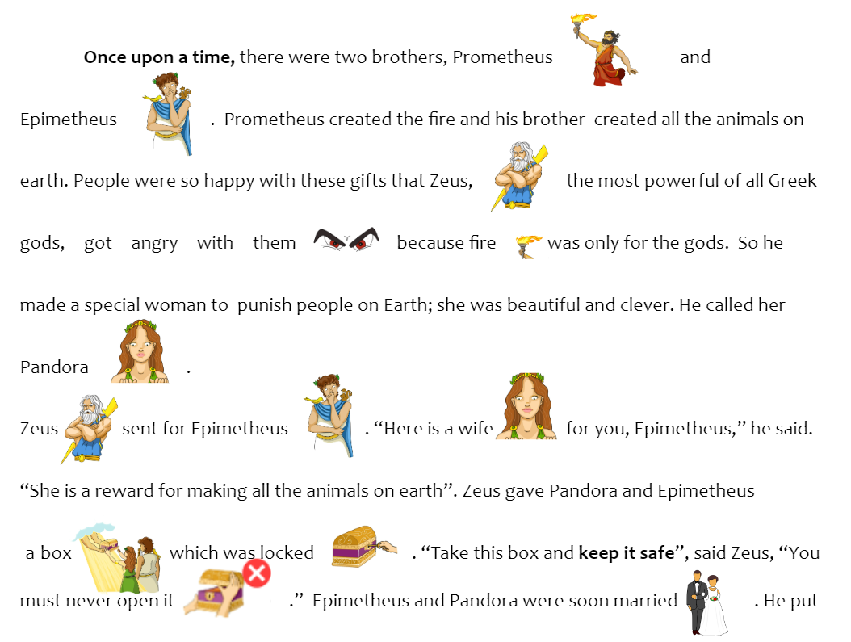
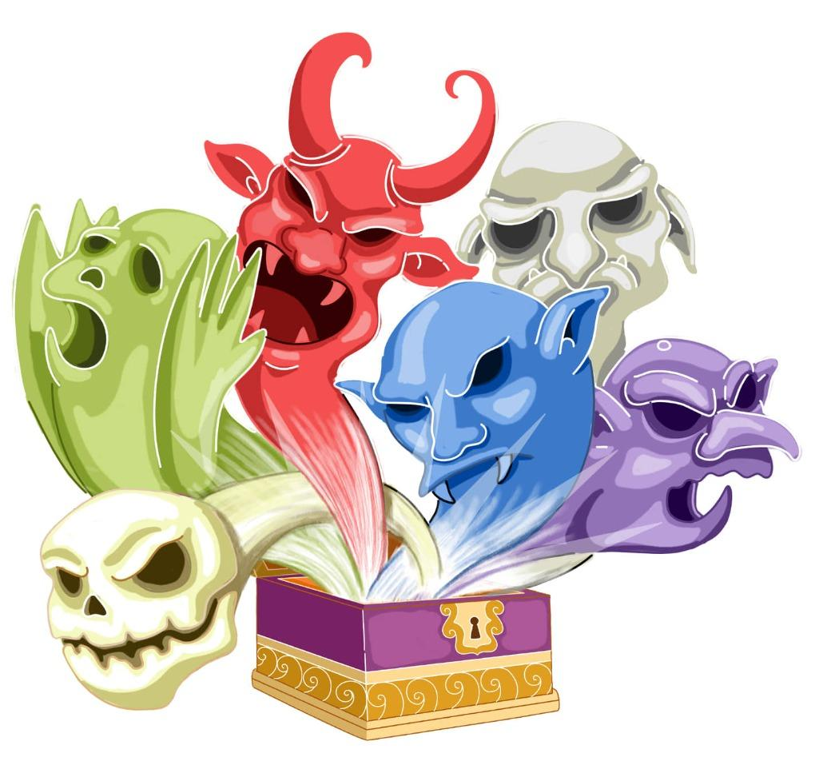
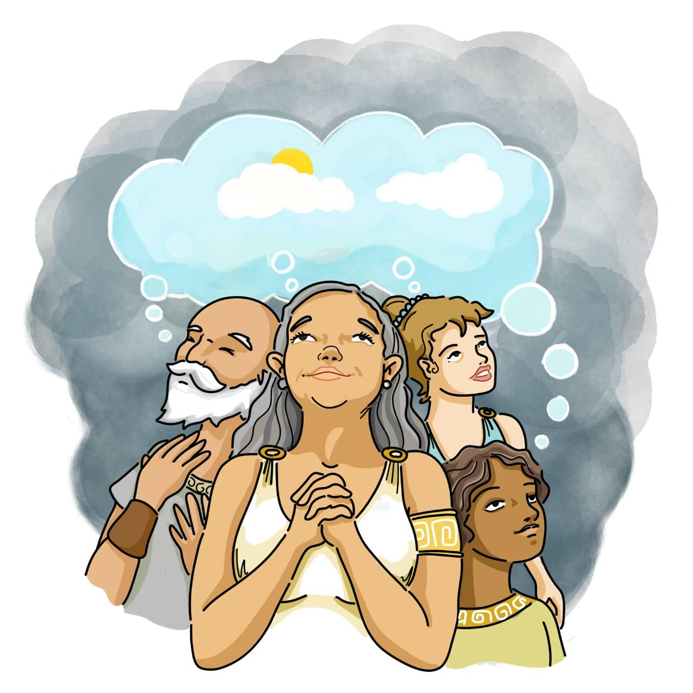
Pandora’s Box

Slide 13
PANDORA
06
ZEUS
03
HORRIBLE THINGS
07
PEOPLE
08
EPIMETHEUS
05
THE BOX
04
ZEUS
01
PEOPLE
09
ZEUS
02

Slide 14
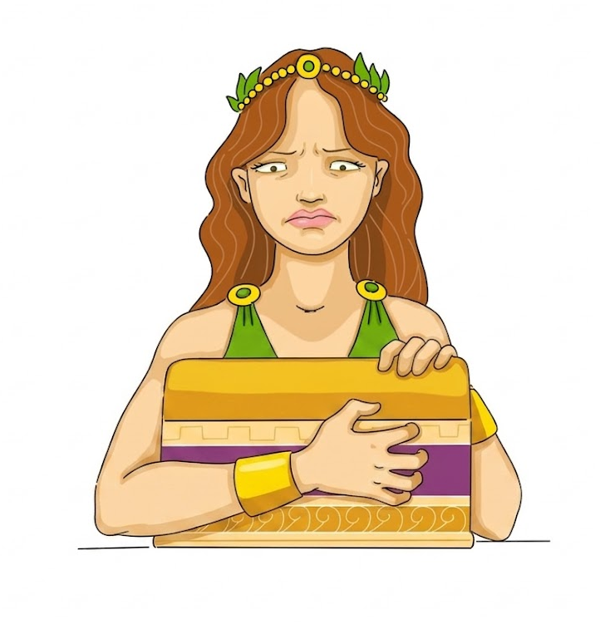
Epimetheus is Pandora ‘s brother. ………………………..
Epimetheus made a special woman. ………………………..
Prometheus married Pandora. ……………………….
Epimetheus gave Pandora the box. ……………………….
Prometheus told Pandora: “Don’t open the box!” ……………………….
Zeus opened the box. ……………………….
Positive things came out of the box. ……………………….
Epimetheus had hope. ………………………..
HUSBAND
ZEUS
EPIMETHEUS
ZEUS
ZEUS
PANDORA
HORRIBLE
PEOPLE

Slide 15

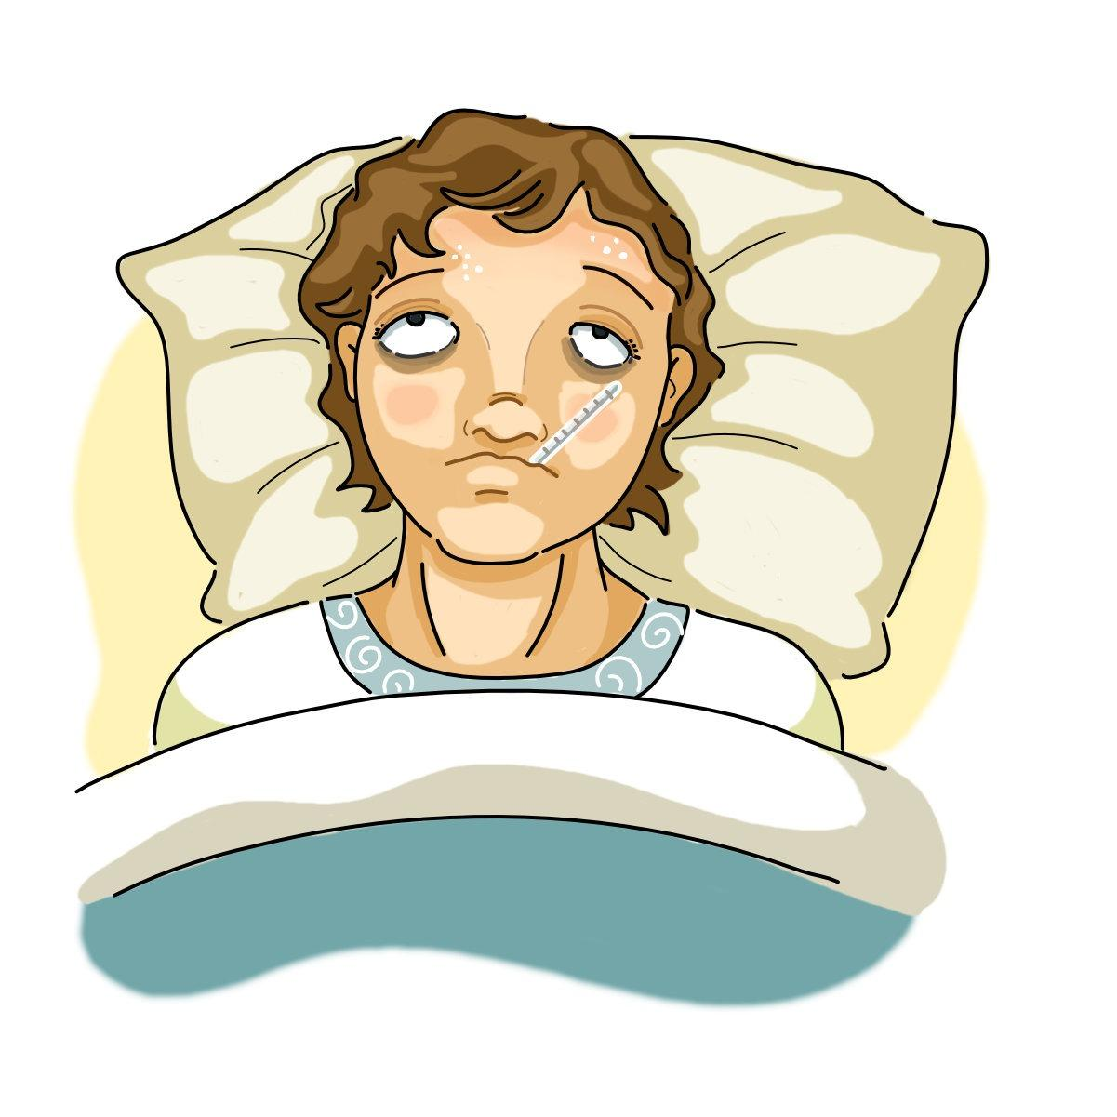

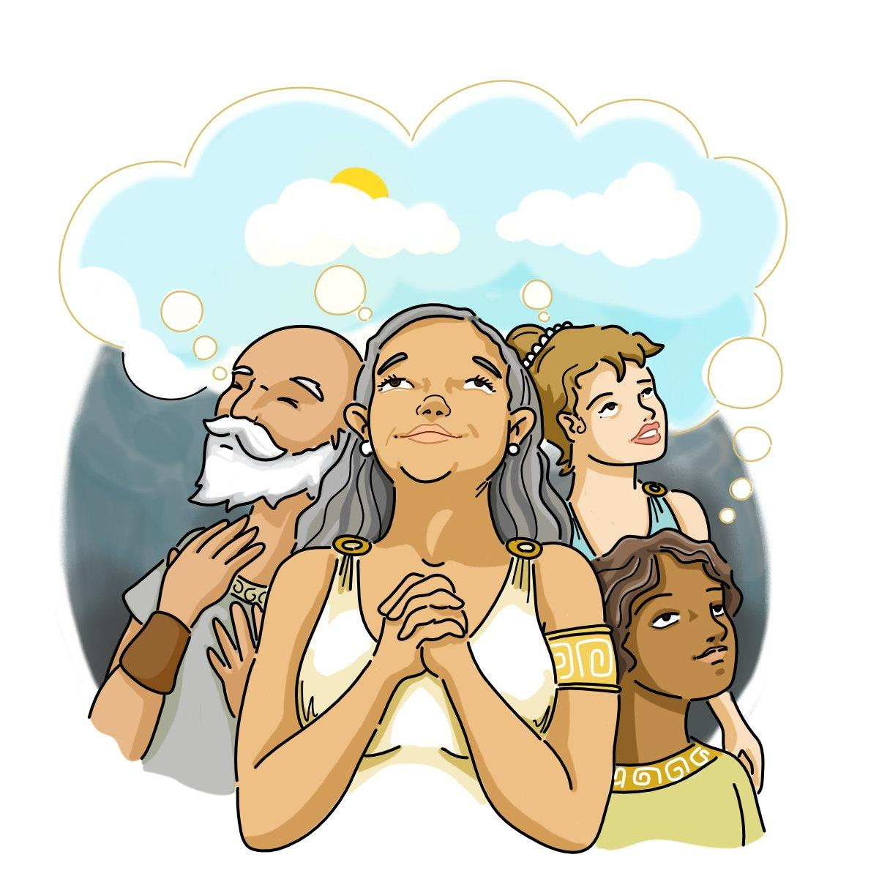
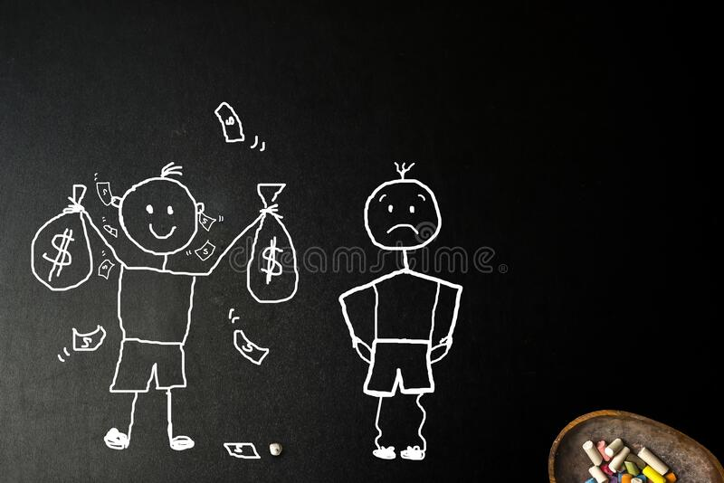
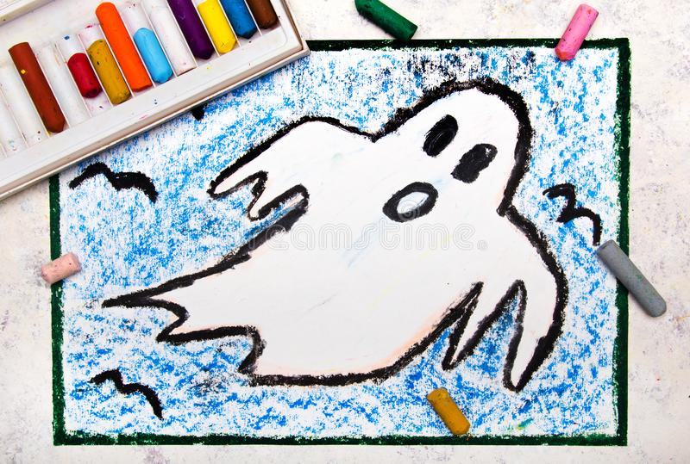
WHAT CAME OUT OF THE BOX?
A) SICKNESS
B) ANGER
C) DEATH
D) POVERTY
E) HOPE
F) GHOSTS

Slide 16
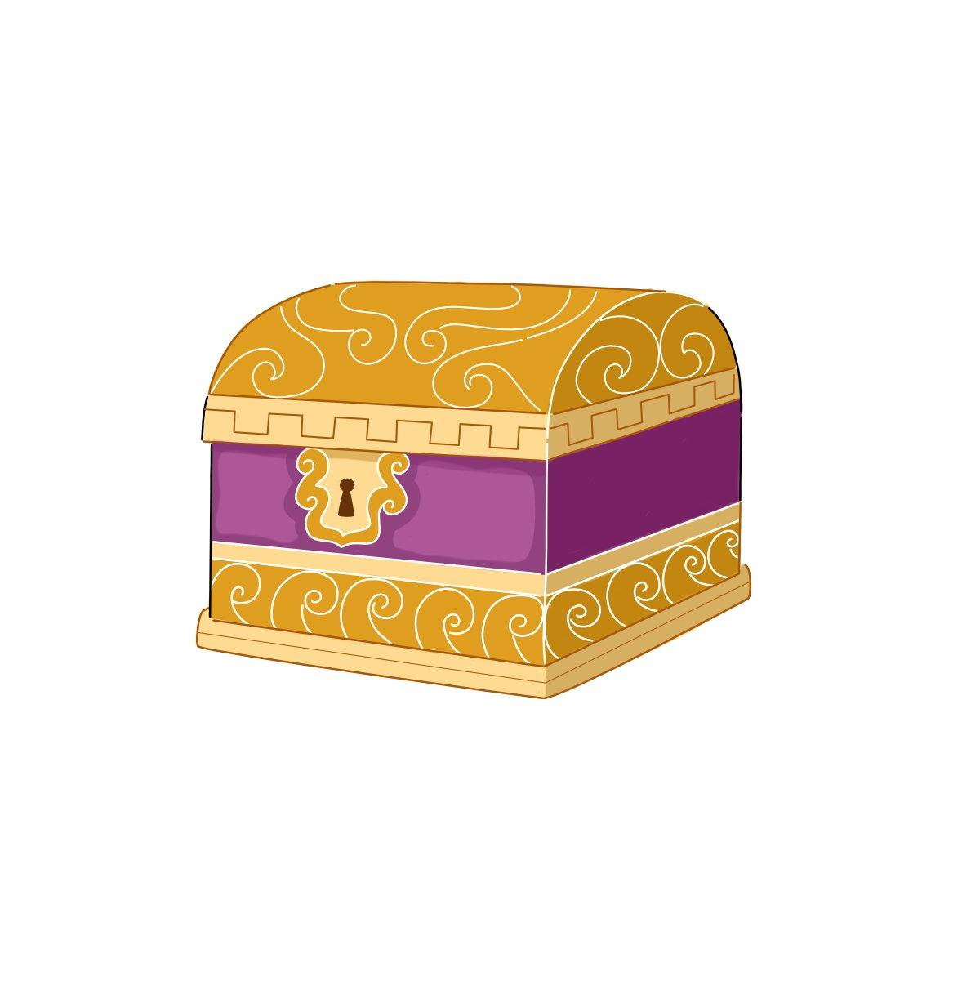
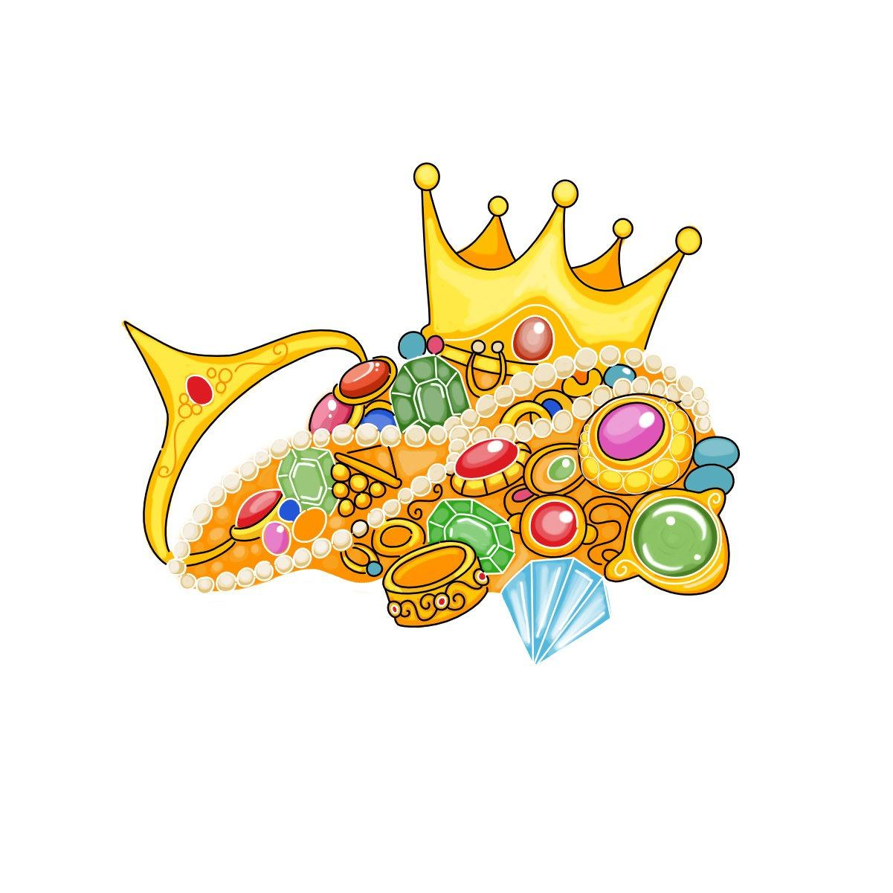


What is “it” in these sentences from the story?
“Take this box and keep IT safe”, said Zeus. “You must never open it”. (line ….)
…the more she thought about IT, the more she wanted to know what was in IT. (lines …& …)
She opened IT. (line …)
9
12
13
16
A) Some jewellery
B) The box
C) A key

Slide 17
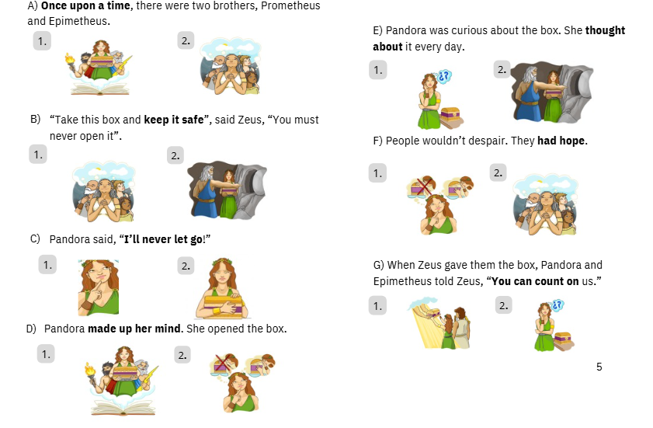


Slide 18
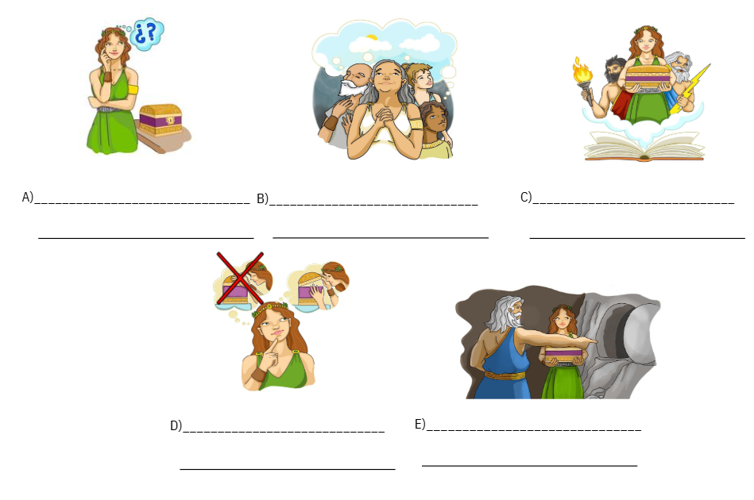
THOUGHT ABOUT IT
HAD HOPE
ONCE UPON A TIME
PENSABA EN ELLA
TENÍAN ESPERANZA
HABÍA UNA VEZ
Tenían esperanza
Había una vez
Se decidió
Seré la luz que te guíe
Mantenela a salvo!
Pensaba en ella
MADE UP HER MIND
KEEP IT SAFE
SE DECIDIÓ
MANTENELA A SALVO

Slide 19
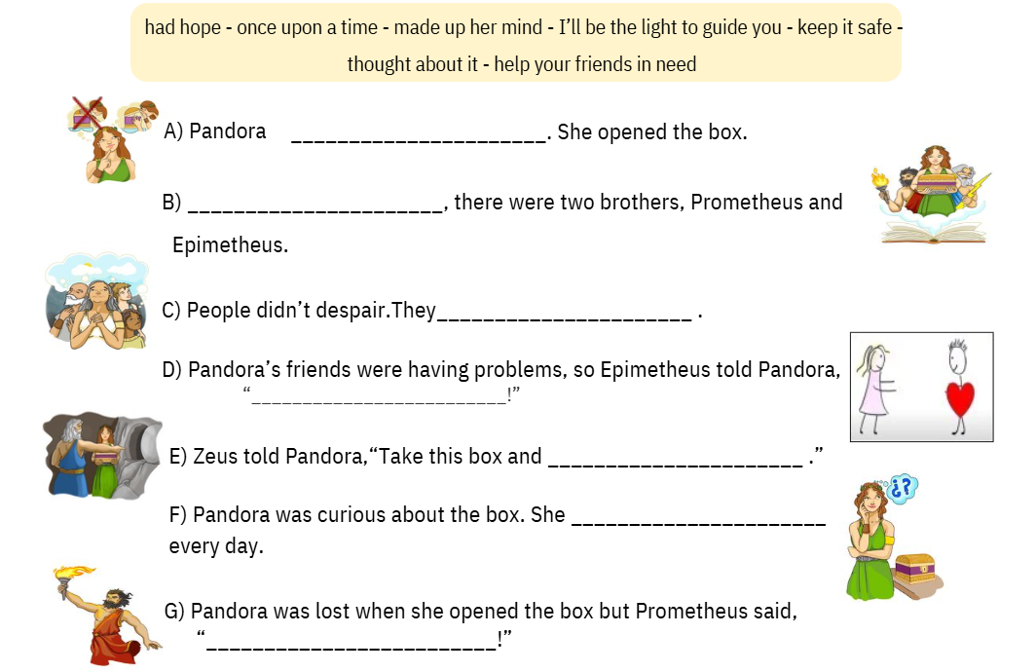
MADE UP HER MIND
ONCE UPON A TIME
HAD HOPE
HELP YOUR FRIENDS IN NEED
KEEP IT SAFE
THOUGHT ABOUT IT
I’LL BE THE LIGHT TO GUIDE YOU

Slide 20

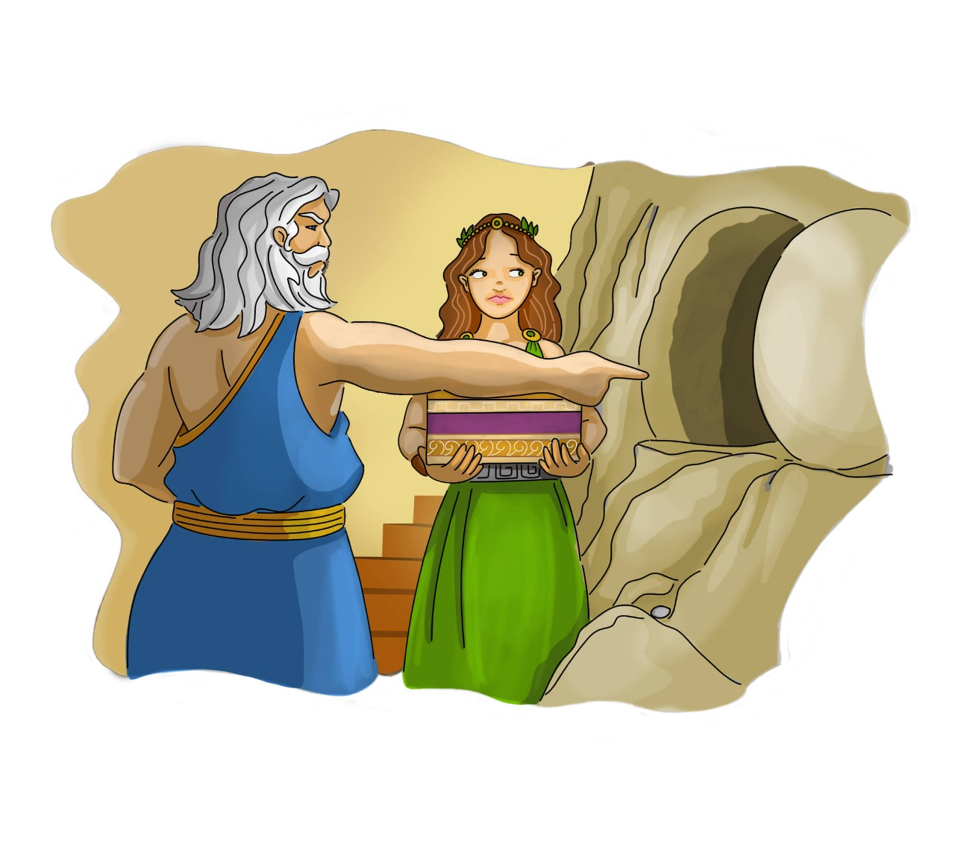
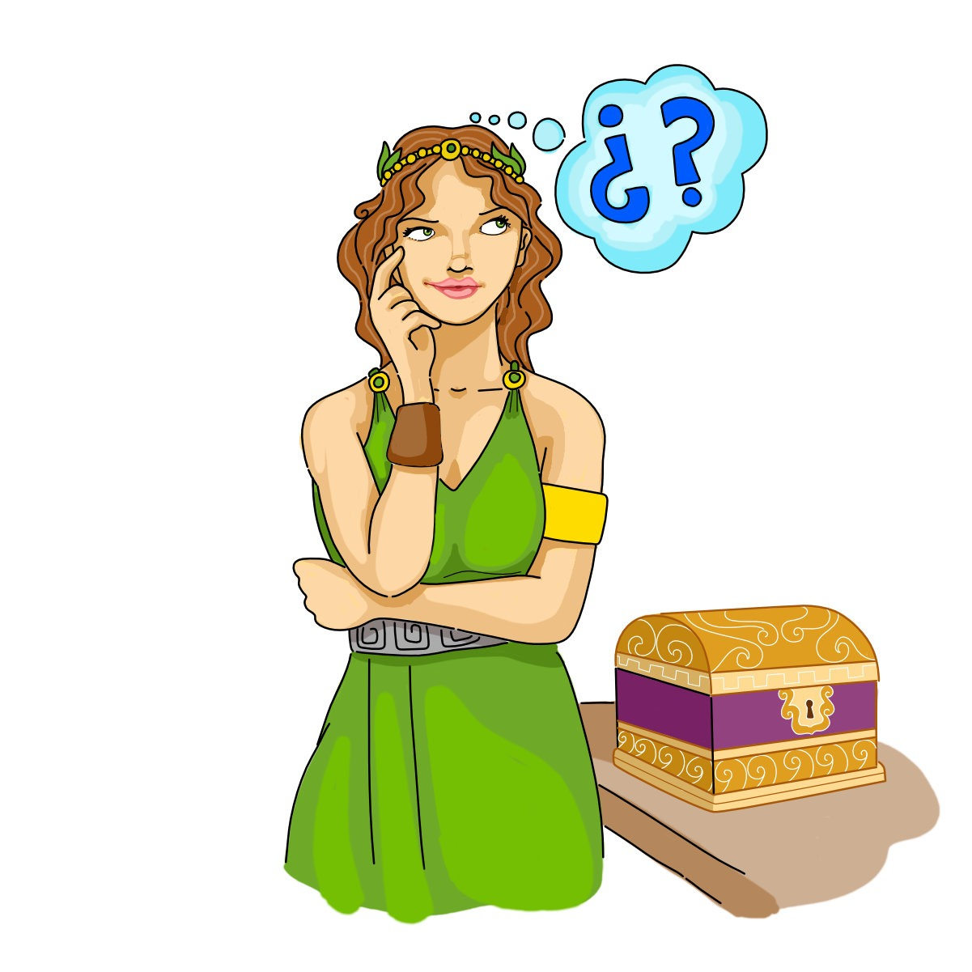
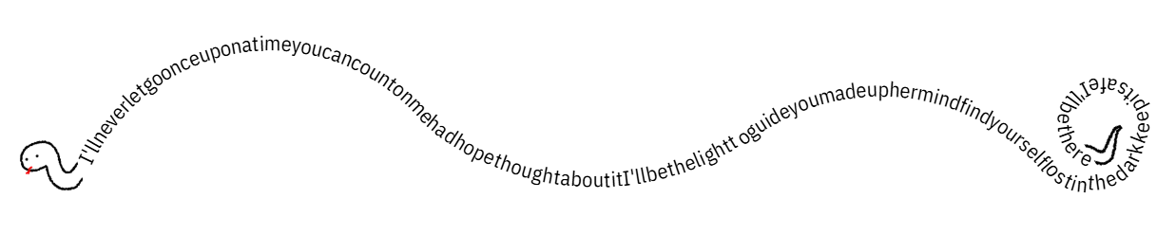
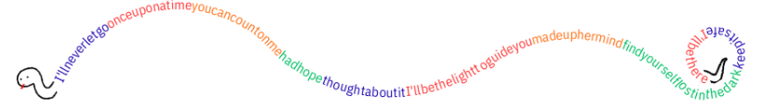

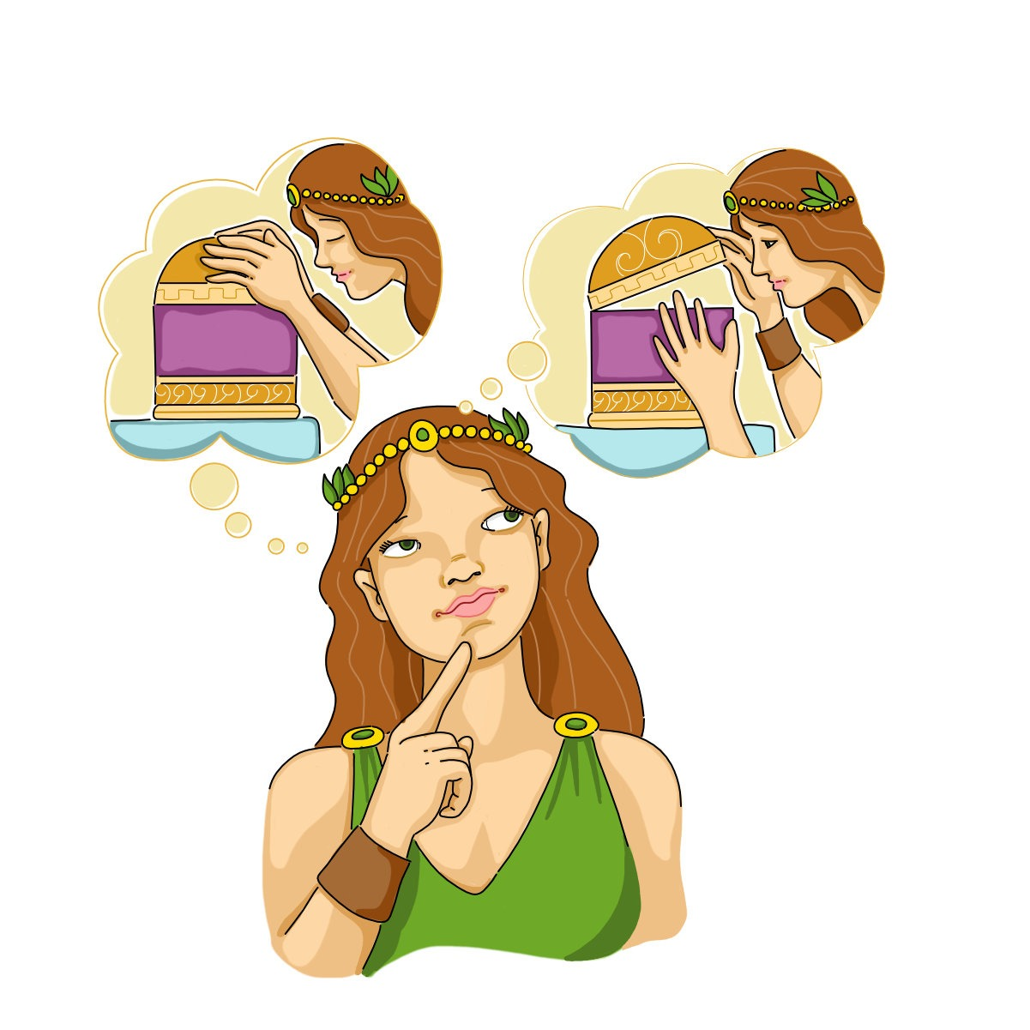
once/upon/a/time…………had/hope//thought/about/it……made/up/her/mind……keep/it/safe
Notes:
-

Slide 21
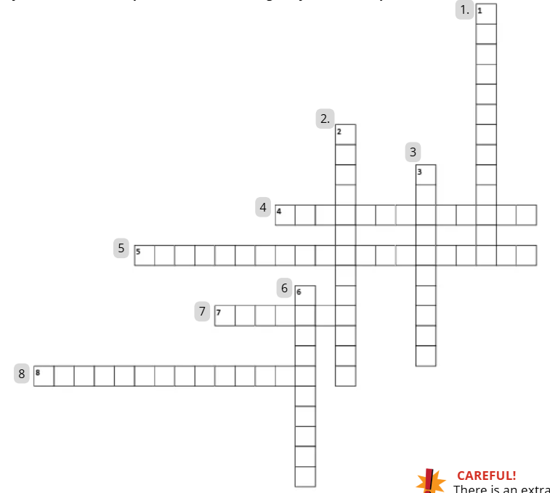
ONCEUPONATIME
ACROSS
ILLNEVERLETGO
KEEPITSAFE
MADEUPHERMIND
DOWN
HELPOURFRIENDSINNEED
COUNTONME
HADHOPE
THOUGHTABOUTIT

Slide 22
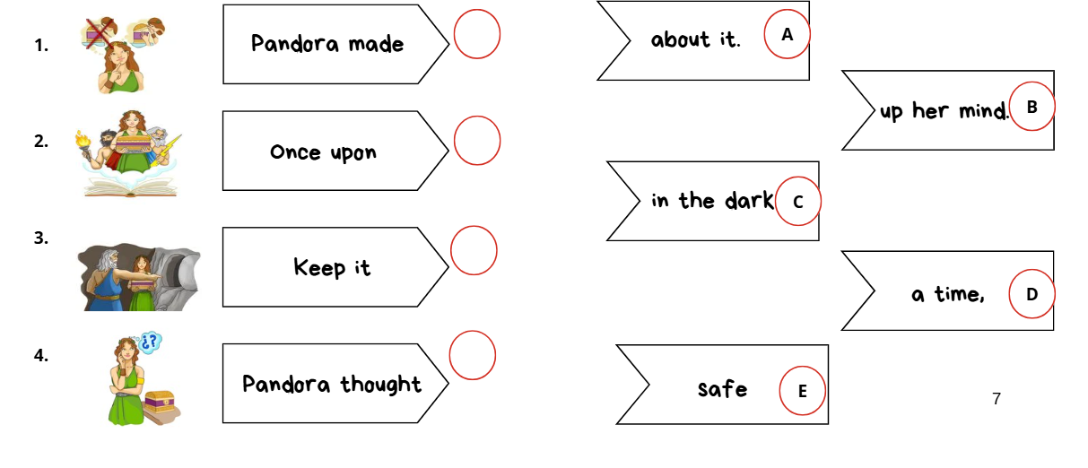
B
D
E
A

Slide 23
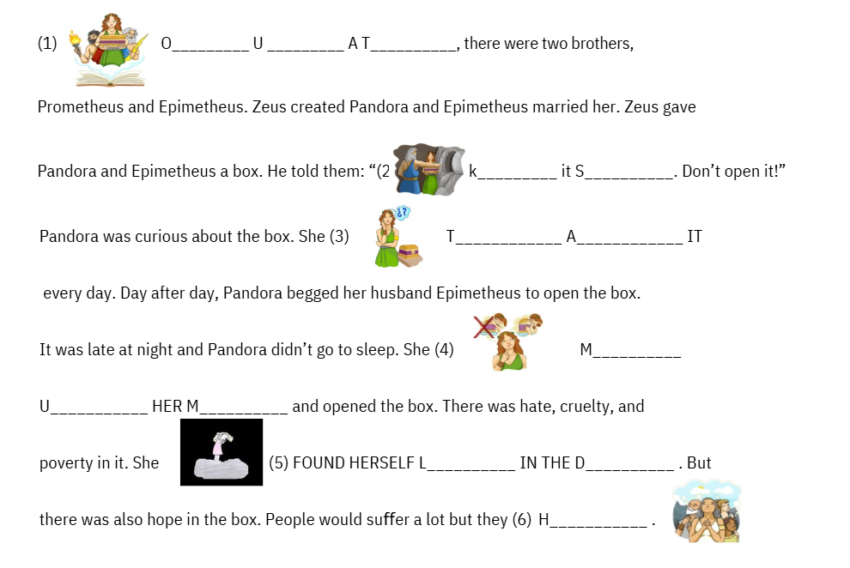
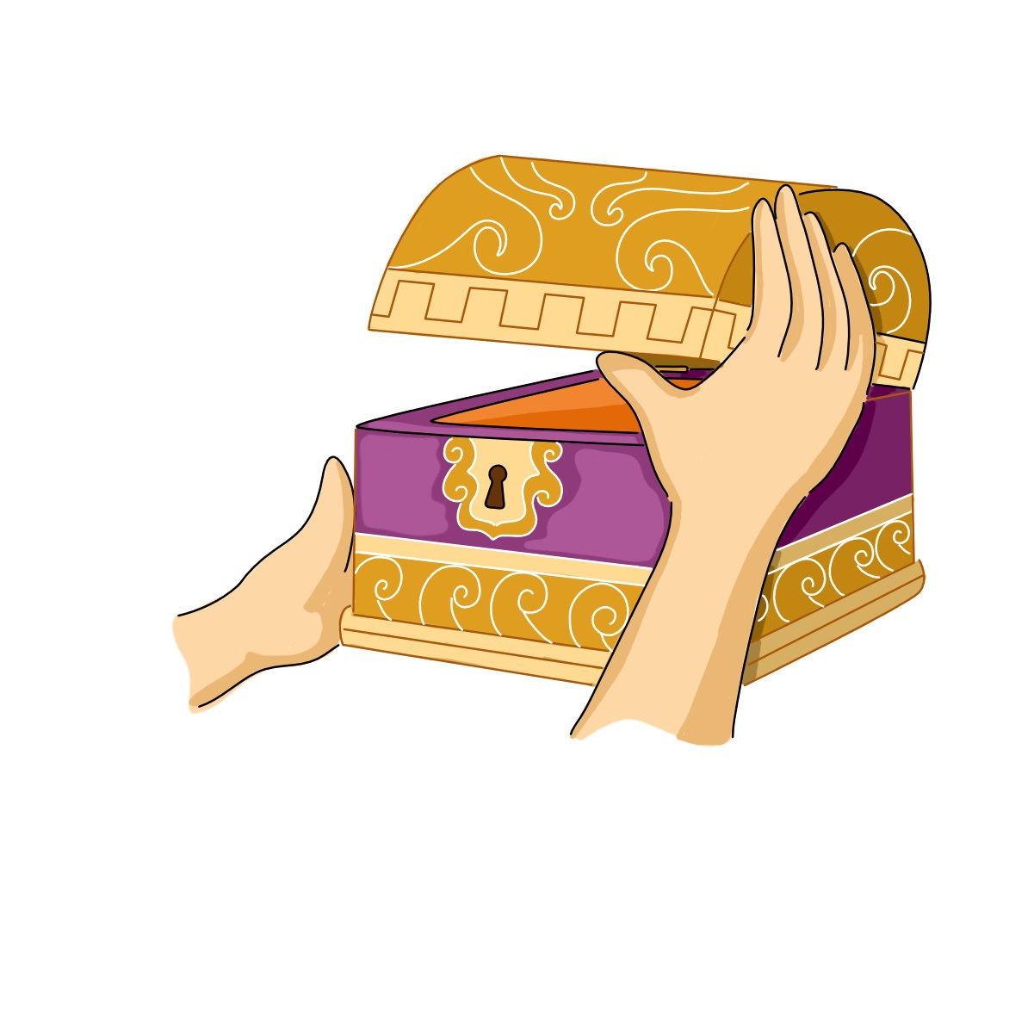
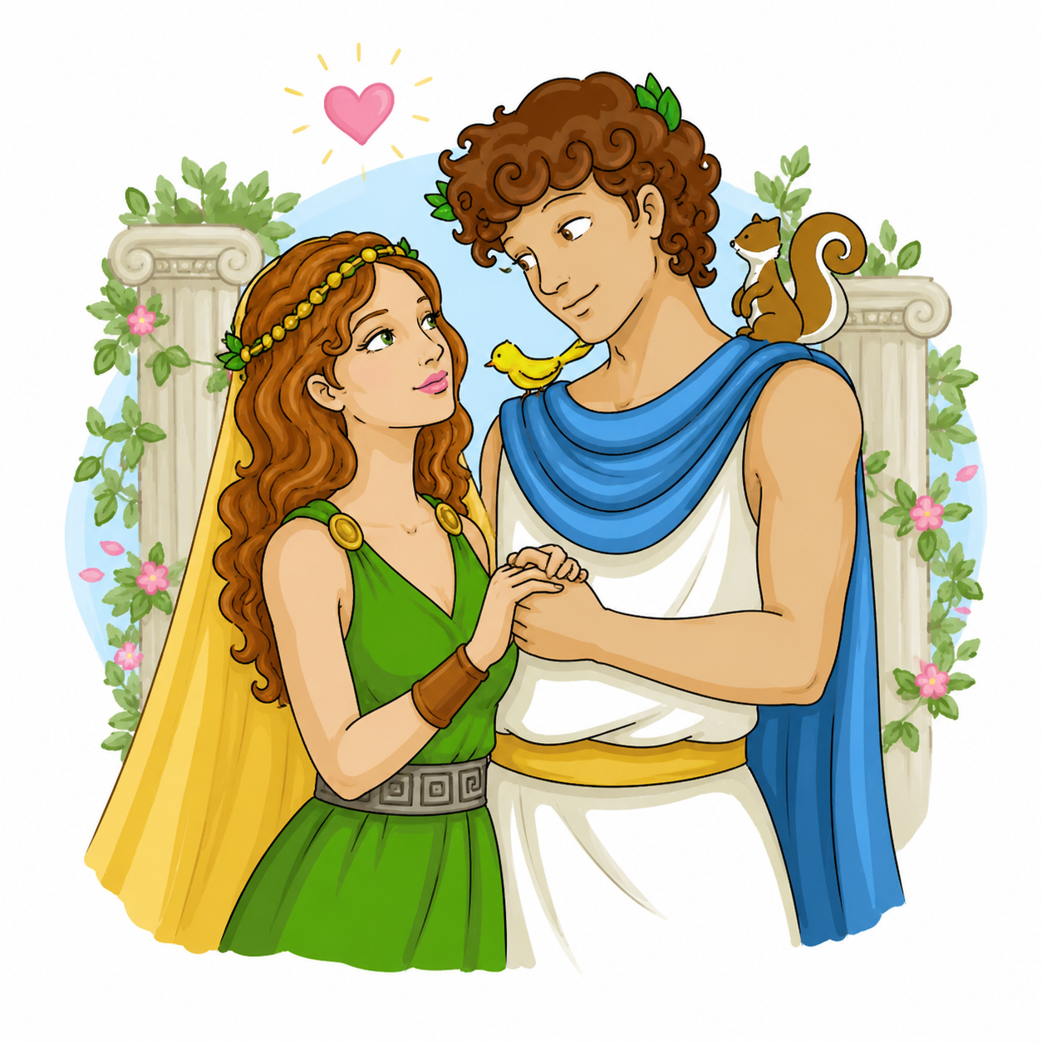
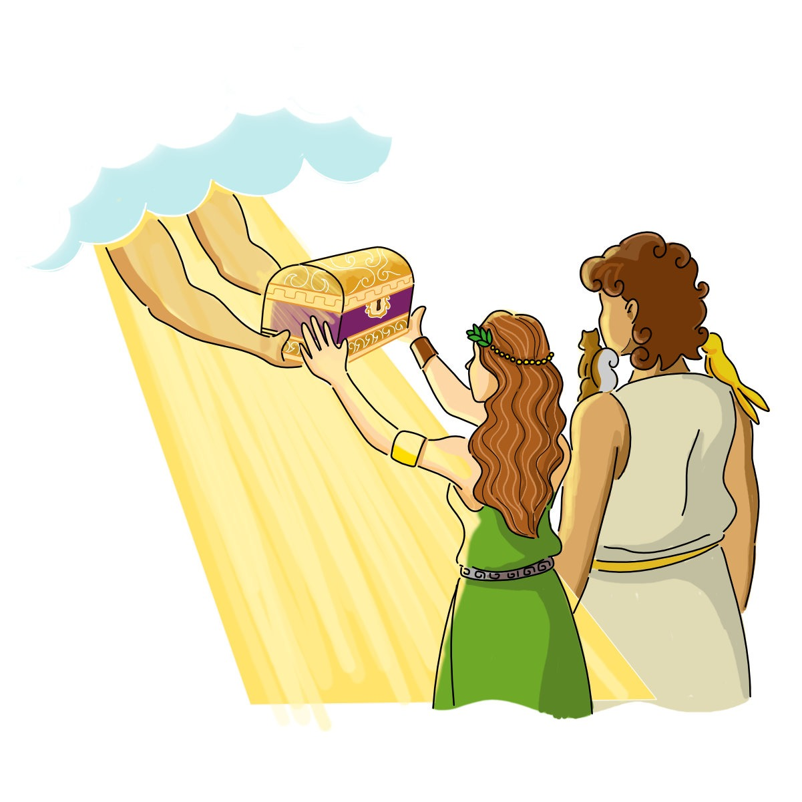
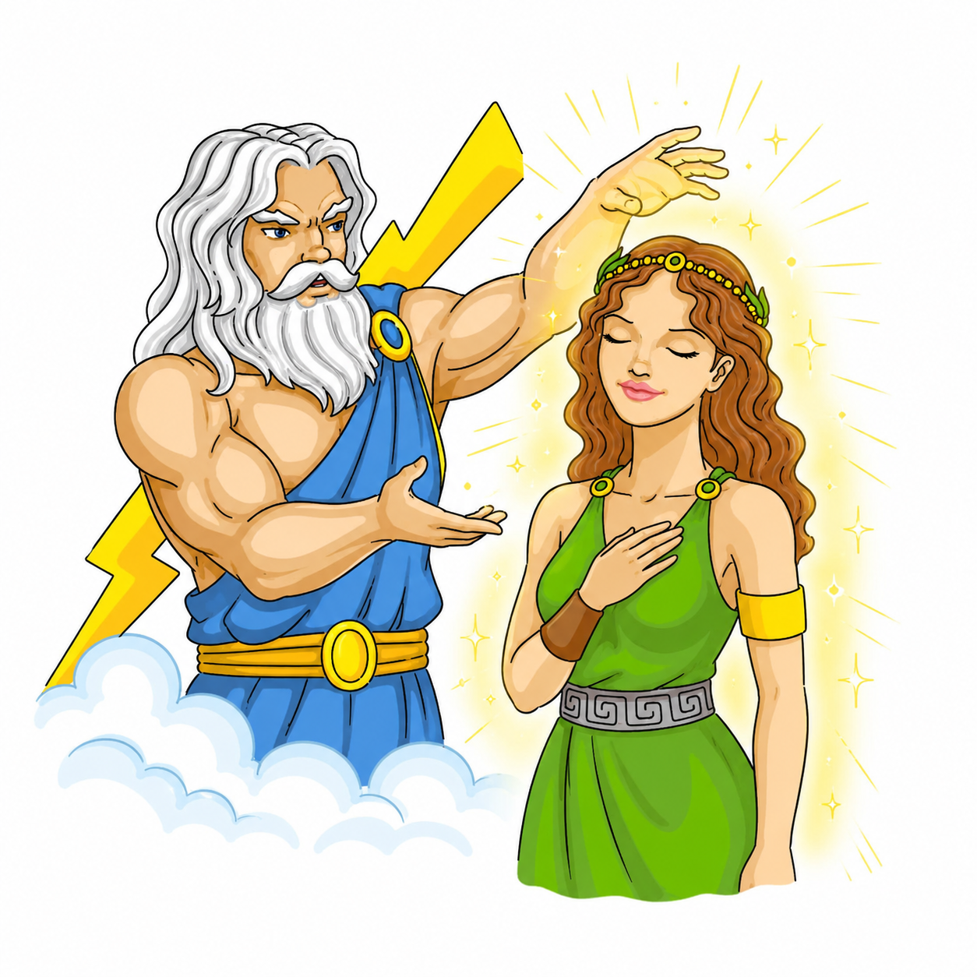
ONCE UPON A TIME
KEEP IT SAFE
A.
THOUGHT ABOUT
B.
C.
MADE UP HER MIND
D.
LOST
DARK
HAD HOPE

Slide 24

What’s the message behind this story?
There is a popular saying in English: “Curiosity killed the cat.” What does it mean? Is it good or bad for people to be curious? How is this saying connected with the story?
Why do you think Zeus gave Pandora this box?
If you were Pandora, would you open this box? Why? Why not?
If you met Pandora, what three questions would you ask her?
If you were a character in Pandora's Box, which problem in today's world would you put back in the box? Why?

Slide 25
¿Cuál es el mensaje del mito?
Hay un dicho popular en inglés: “Curiosity killed the cat.” ¿Qué significa? ¿Es bueno o malo ser curioso? ¿Cómo se relaciona el dicho con el mito?
¿Por qué le dio Zeus la caja a Pandora?
Si fueras Pandora, ¿abrirías la caja? ¿Por qué? ¿Por qué no?
Si te encontraras con Pandora, ¿qué tres preguntas le harías?
Si fueras un personaje de Pandora's Box, ¿qué problema del mundo de hoy meterías en la caja? ¿Por qué?

Slide 26
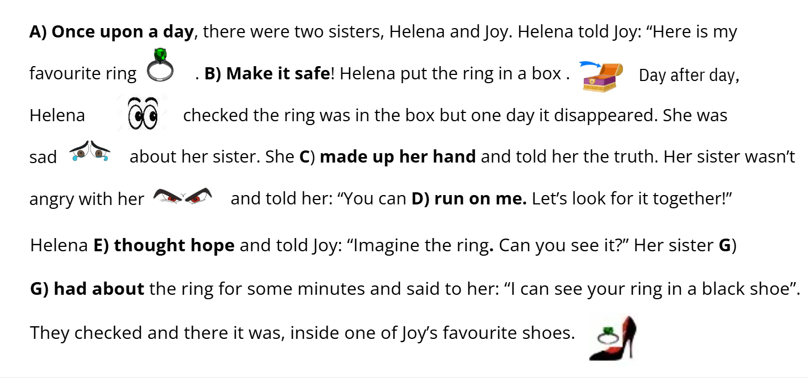
ONCE UPON A TIME
KEEP IT SAFE
MADE UP HER MIND
COUNT ON ME
HAD HOPE
THOUGHT ABOUT

Slide 27
Once upon a time, there were two brothers, Prometheus and Epimetheus. Zeus created Pandora and Epimetheus married her. Zeus gave Pandora and Epimetheus a box. He told them: “Keep it safe. Don’t open it!” Pandora was curious about the box. She thought about it every day. One night Pandora couldn’t sleep. She made up her mind and opened the box. There was hate, cruelty, and poverty in it. But there was also hope in the box. People would suffer a lot but they had hope.

Slide 28
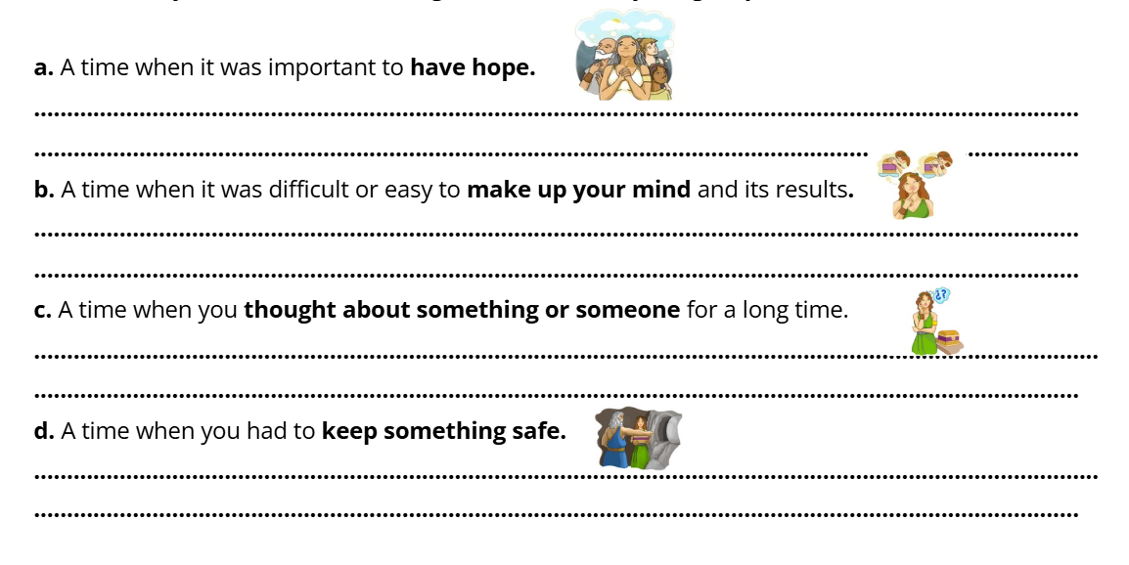

Slide 29

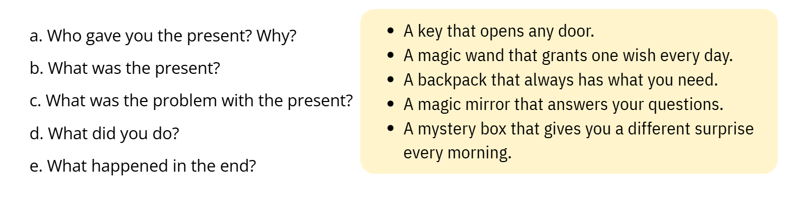



Slide 30
